Slide 1
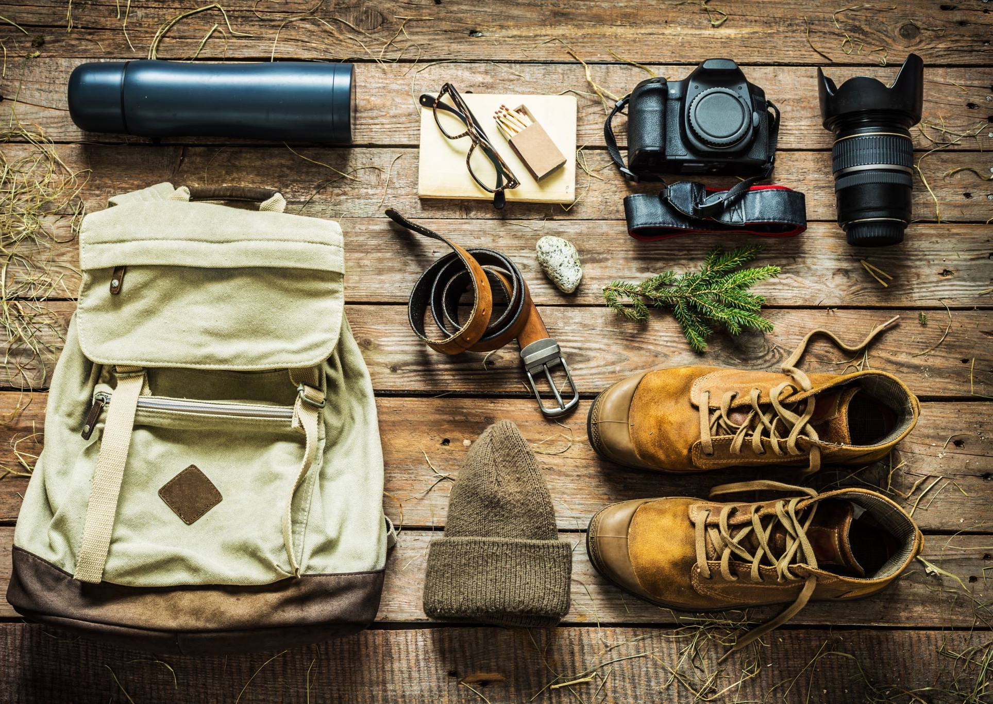
Scouting America Troops 171B & 171G

Slide 2
Your Troop At A Glance
Grace Commons Church has been our benefactor since 1952 – but there is no proselytizing
We offer camping experiences every month of the year
Formal Leadership Training Opportunities
We follow BVSD – if there is a holiday, we do not meet. If there is a long weekend, we are likely camping!
Centered around Monday Meetings (Aug – May)
Spring Break Trips – generally in Utah
All ability levels are accommodated
Week-long “traditional” Summer Camps and summer Colorado back country trips are offered
Afternoon/Evening summer “Rotations” (hiking, biking, water crossing training, rock climbing, etc)
2-Week High Adventure trips (bigger trips on an approx. 3-year rotation)
Parents are strongly encouraged to participate in all activities and trips
You will likely not be more directly involved with your son or daughter, than with this Troop

Slide 3
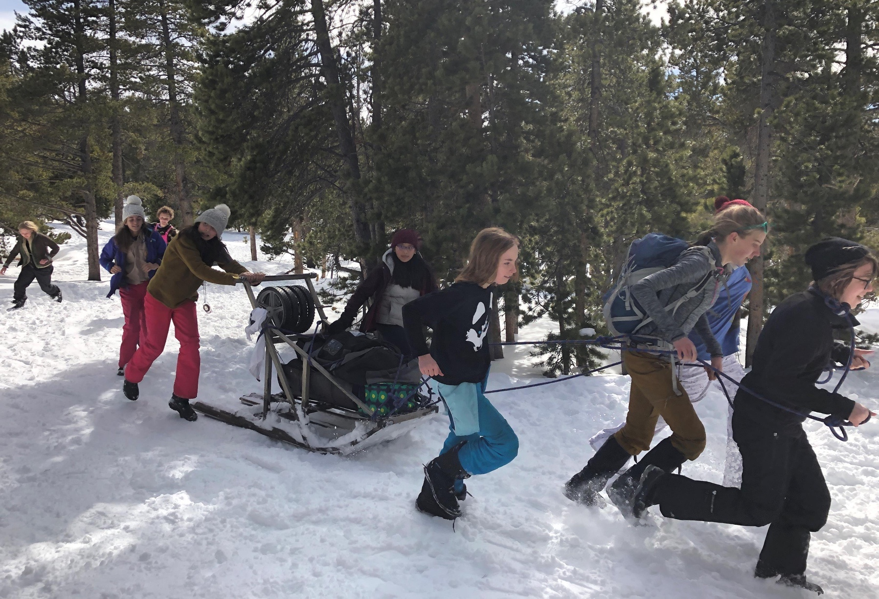
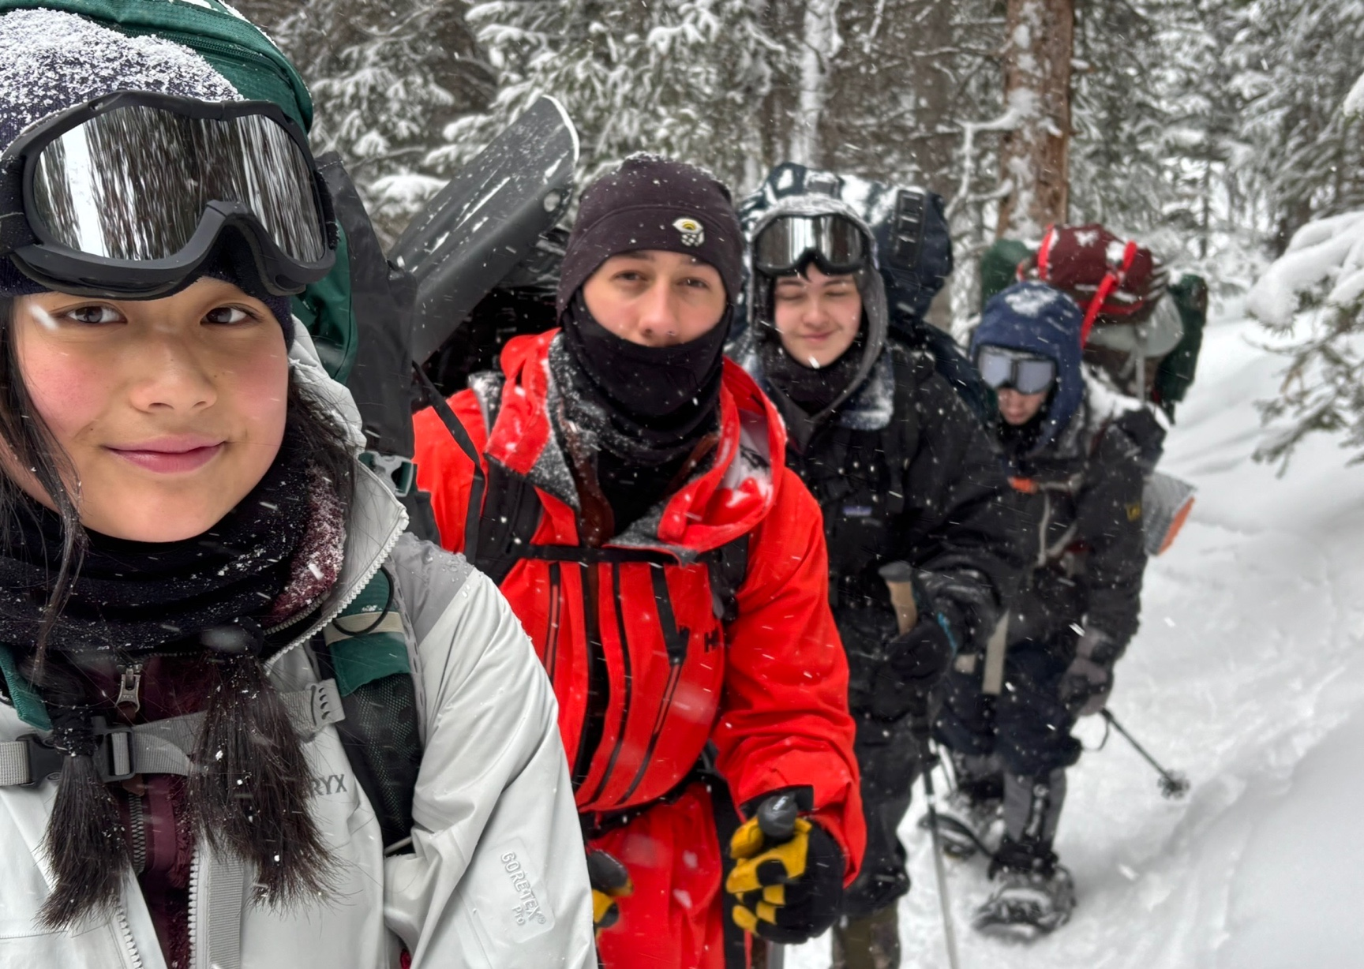
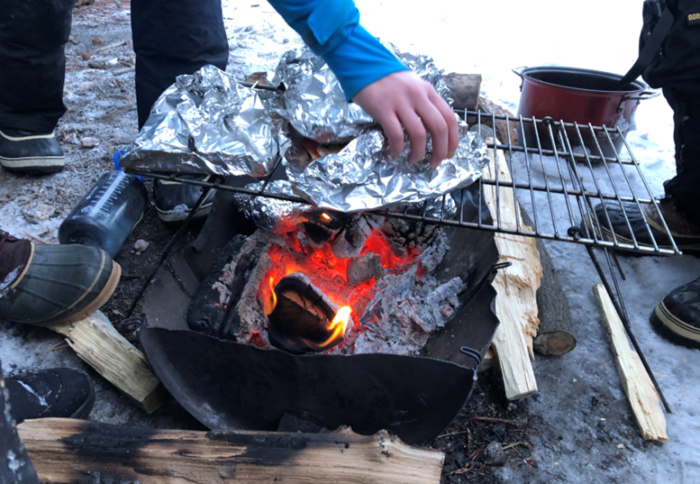
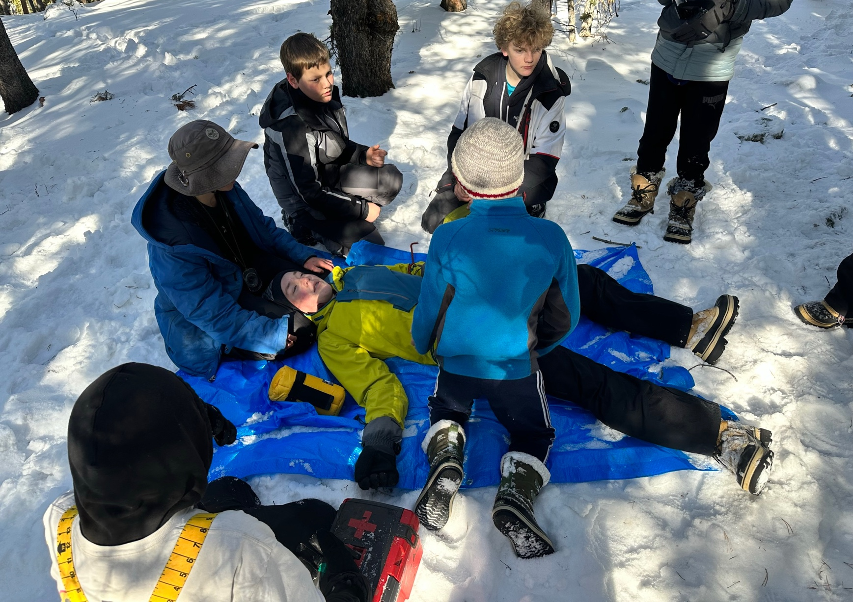
January/ February
Backpacking opportunities for older Scouts
Winter car camping focused on the Klondike Winter Skills Event
+200 Scouts from around the region compete to complete challenges as best they can
Highlights basic Scouting skills as well as teamwork, leadership and problem solving

Slide 4
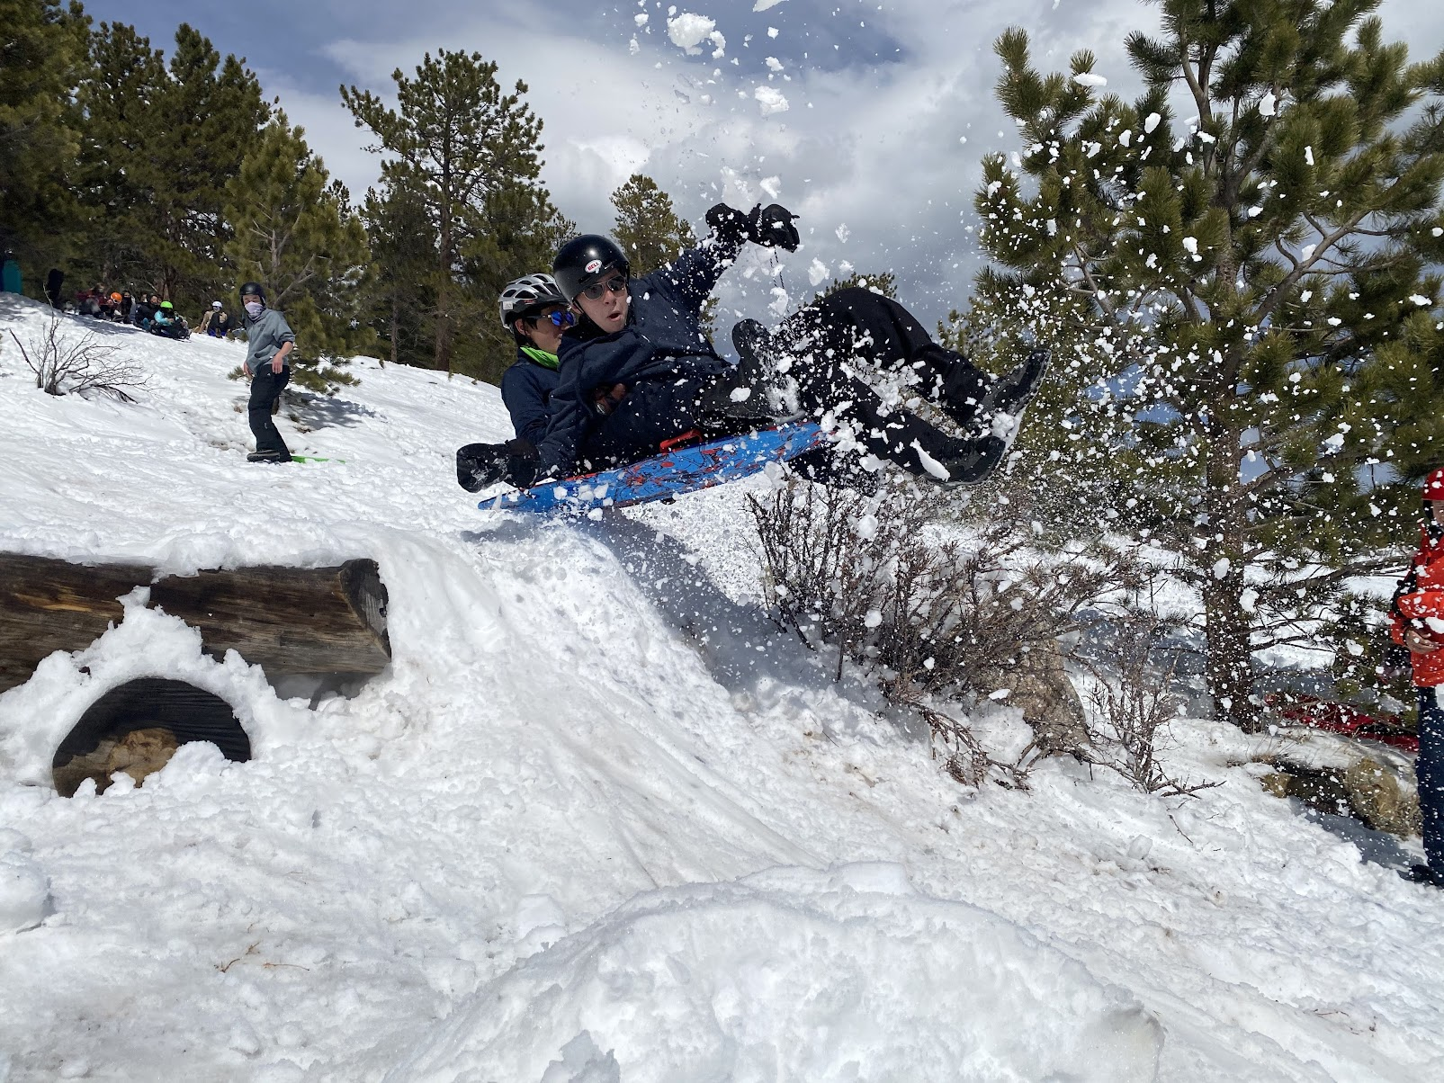
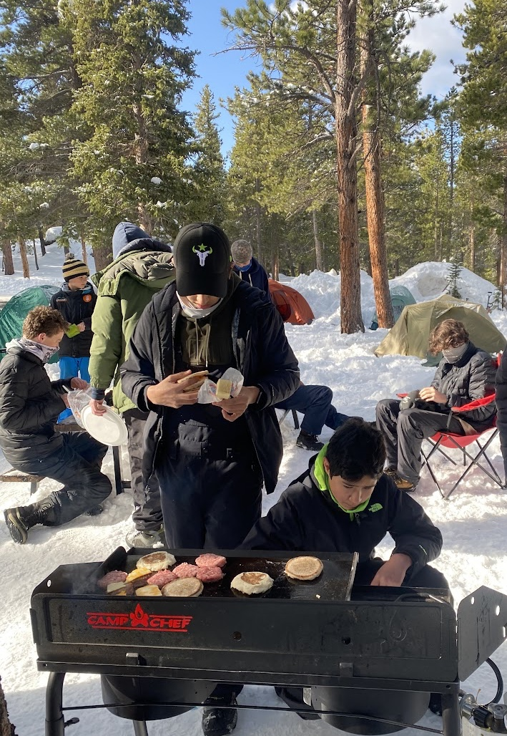
Springtime in the Rockies!
Capitalize on our warmer, snowy environment
Colorado Hut Trip
Winter Sports Weekend at YMCA Snow Mountain Ranch
3 tiers of Spring Break trips, typically in Utah
Entry Adventure
Mini Adventure
High Adventure
All 3 ability levels re-group for a restaurant dinner in Utah and a stop at the Glenwood Hot Springs pool

Slide 5
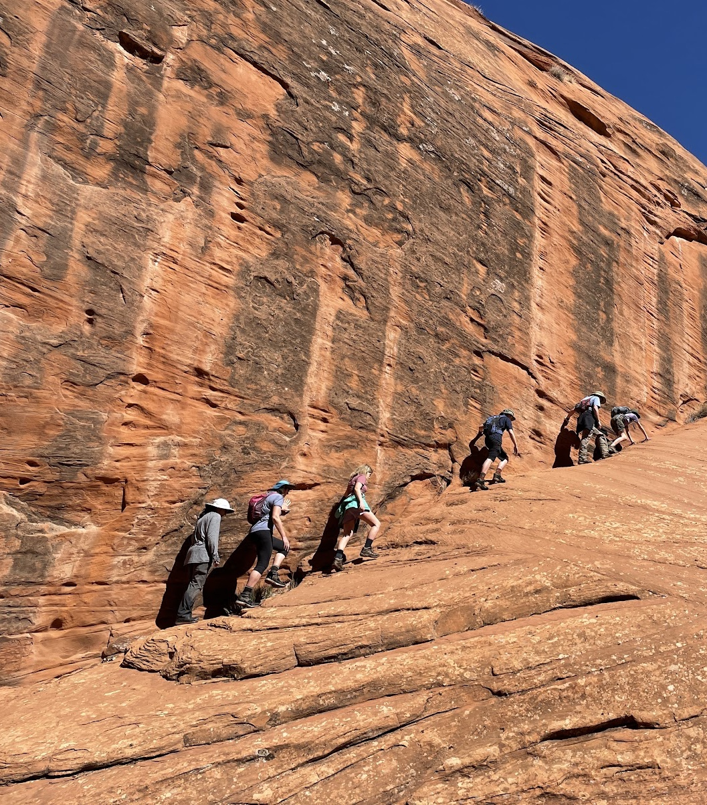
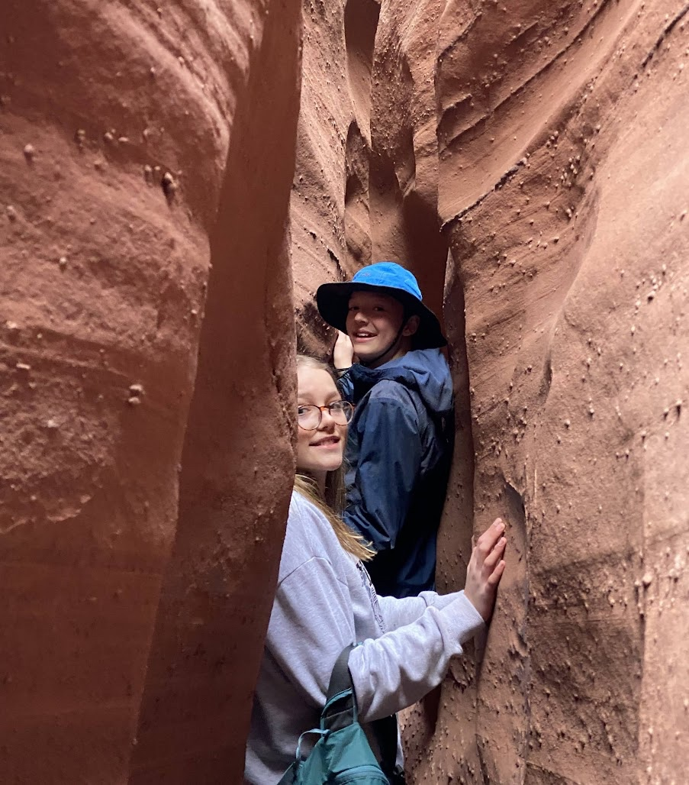
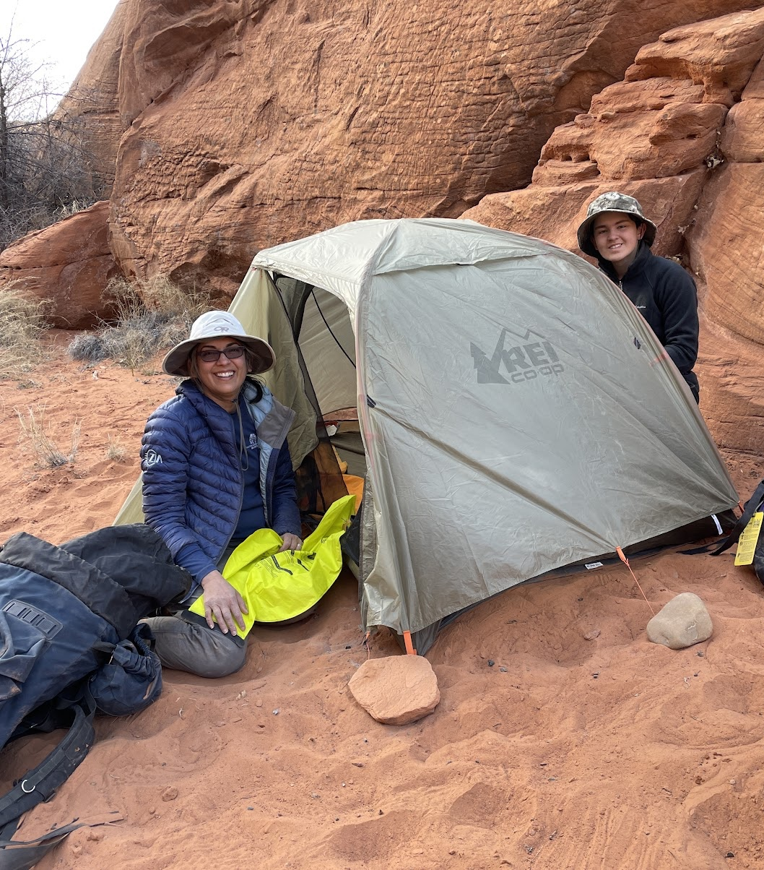
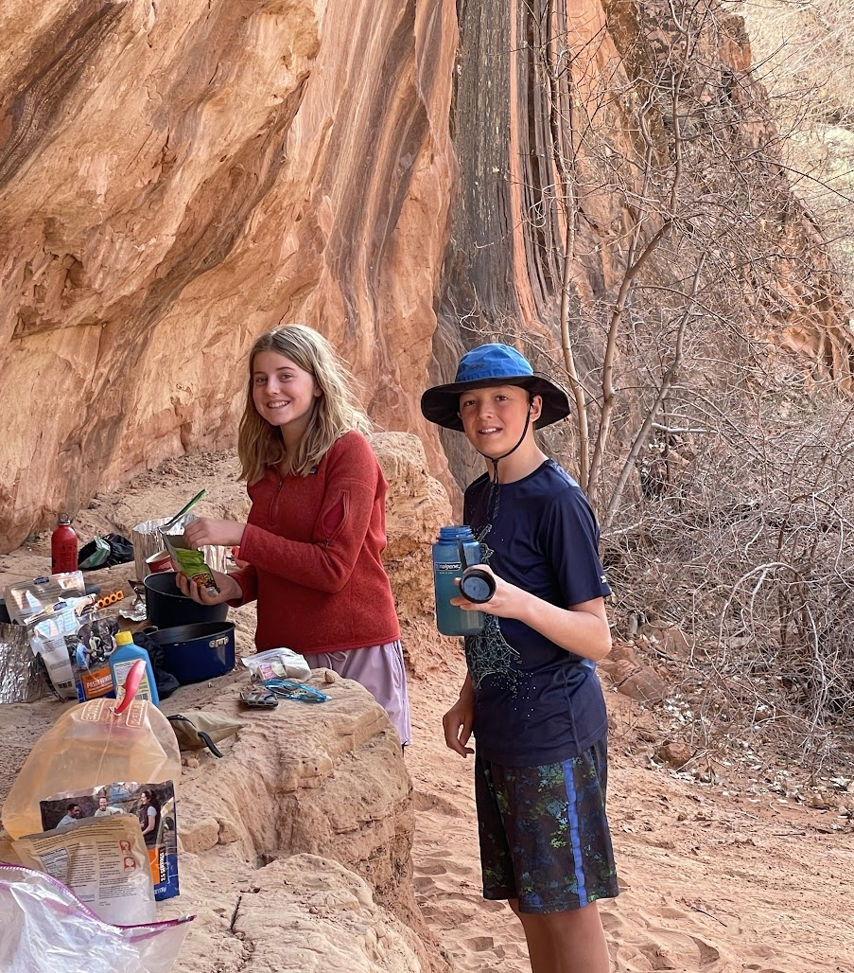
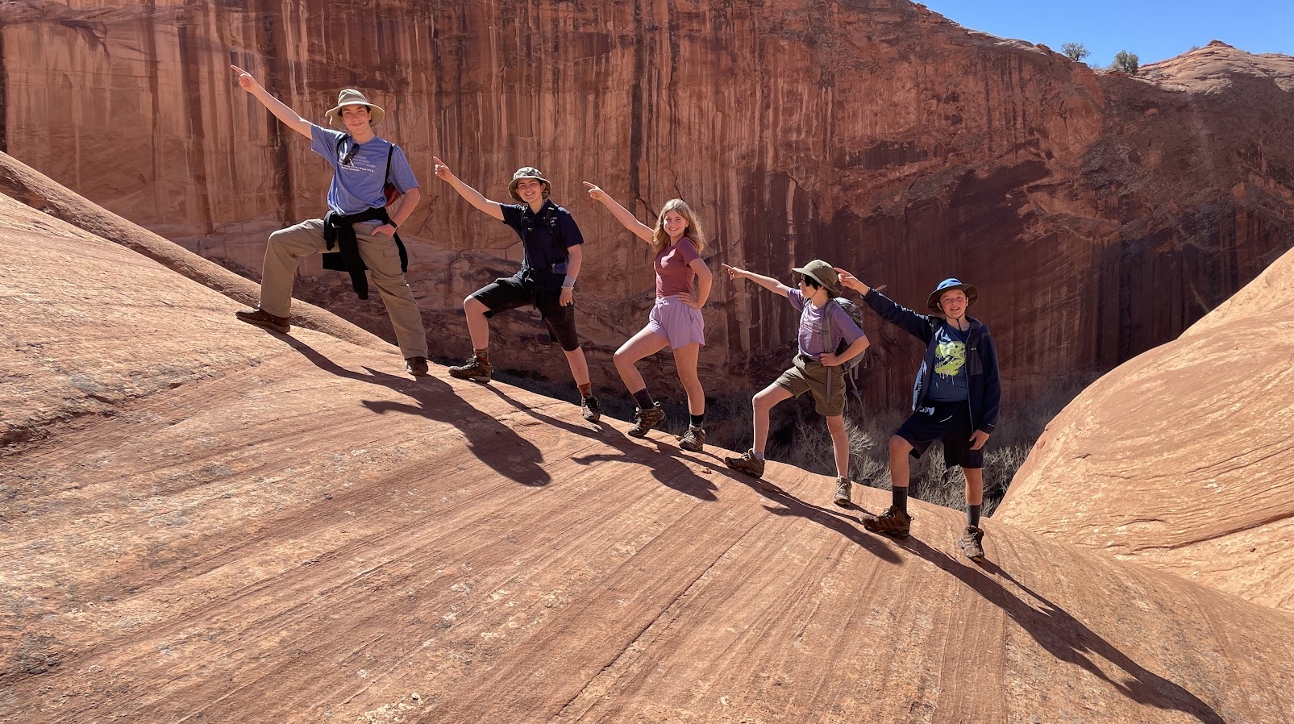
Spring Break – Entry Level
Harris Wash – South of Capital Reef NP
Backpack to a “central location” and then enjoy shorter explorations
Spooky and Peek-A-Boo slot canyon are “tight”!

Slide 6
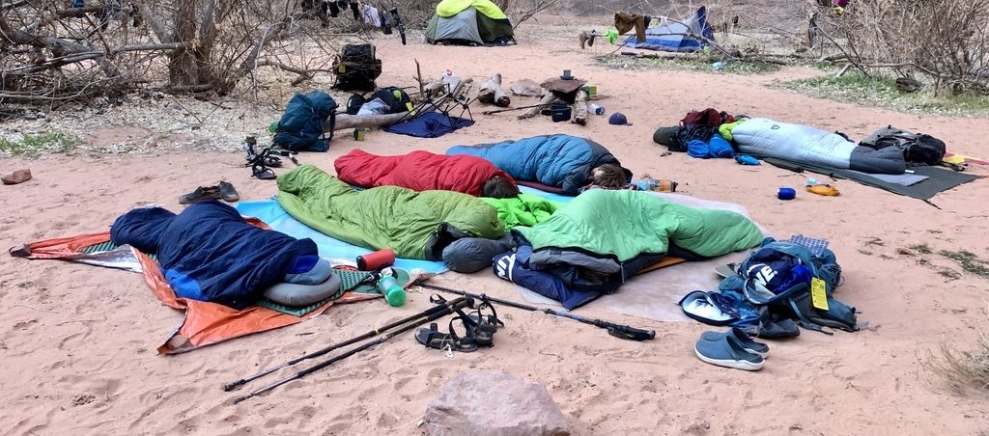
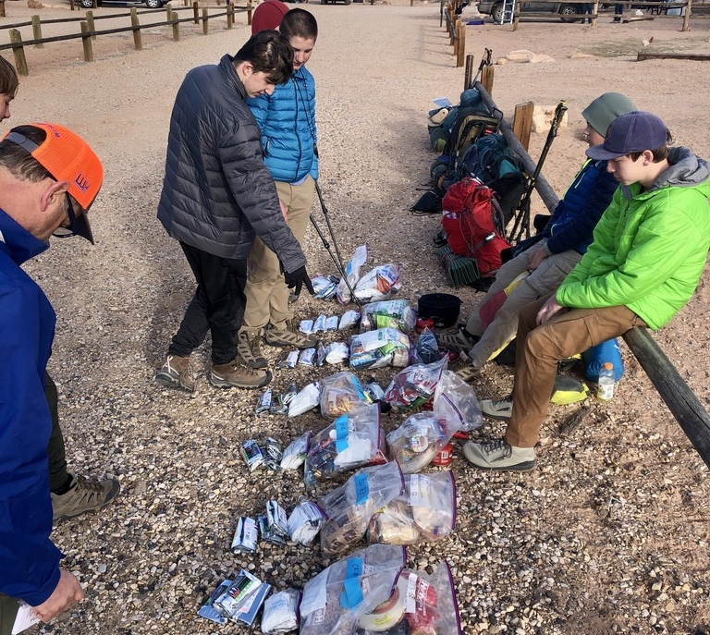
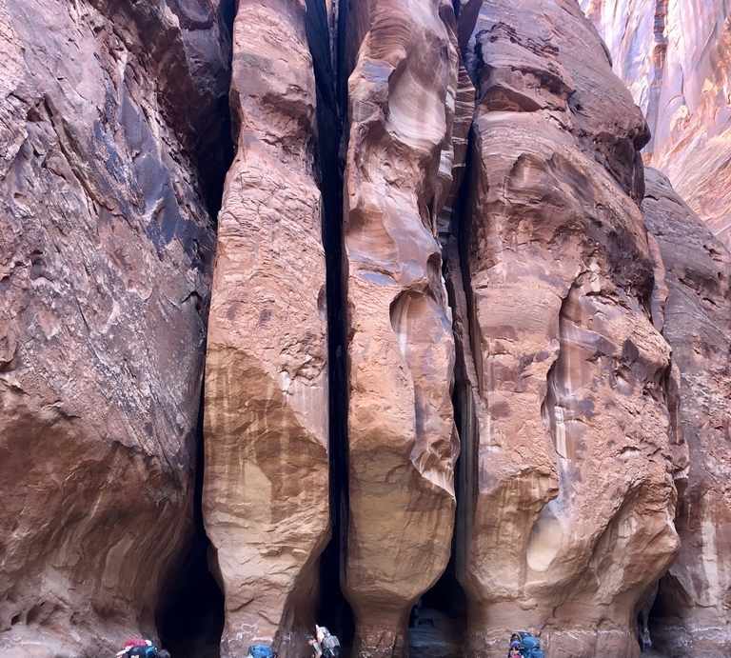
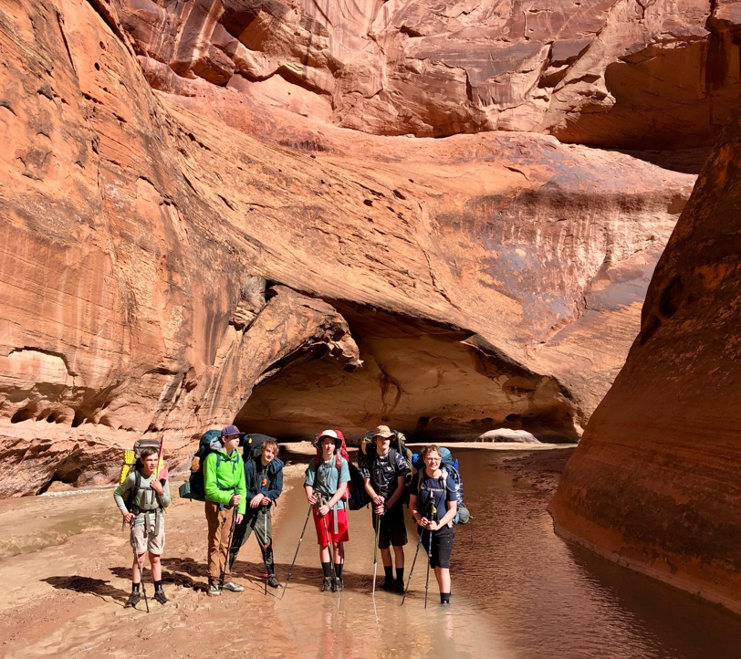
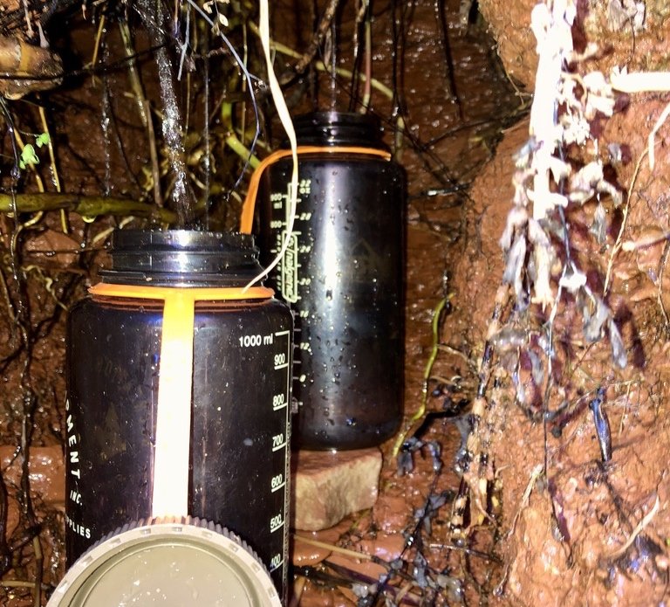
Spring - Mini
Longer distances
Heavier packs
More maturity and self-reliance is expected
~50 mile “descent” of the Paria River, to Page AZ

Slide 7
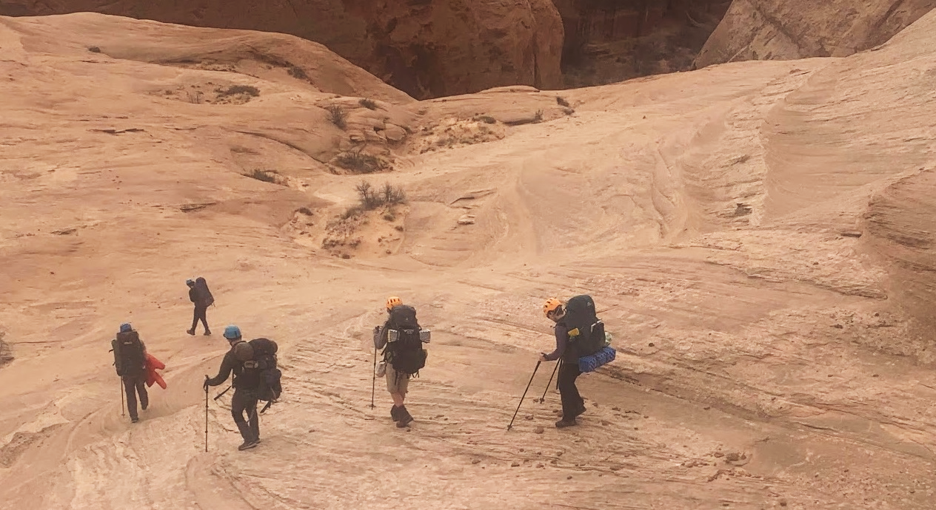
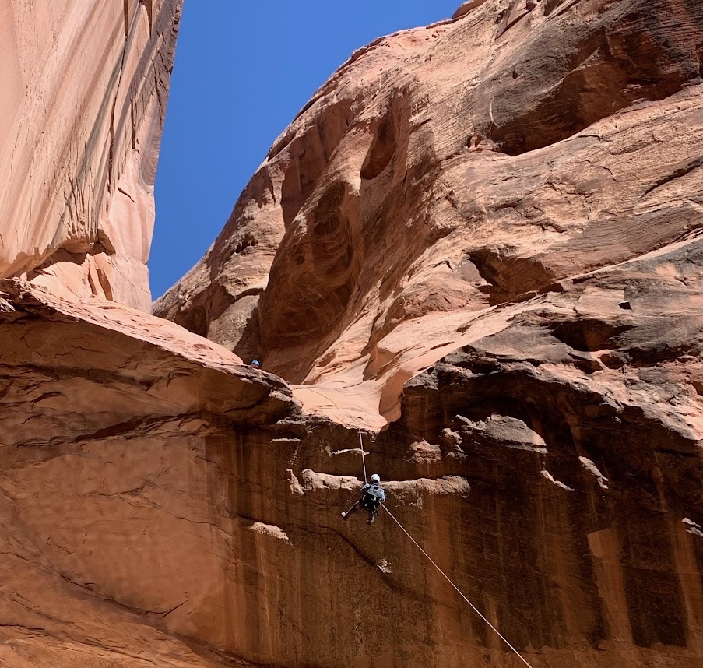
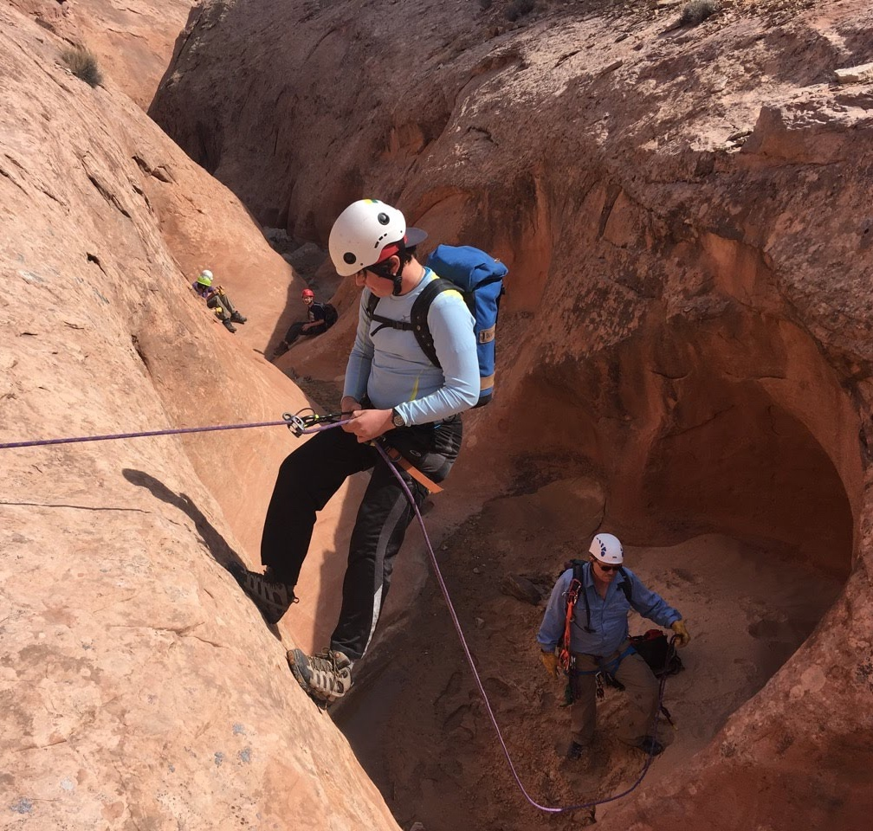
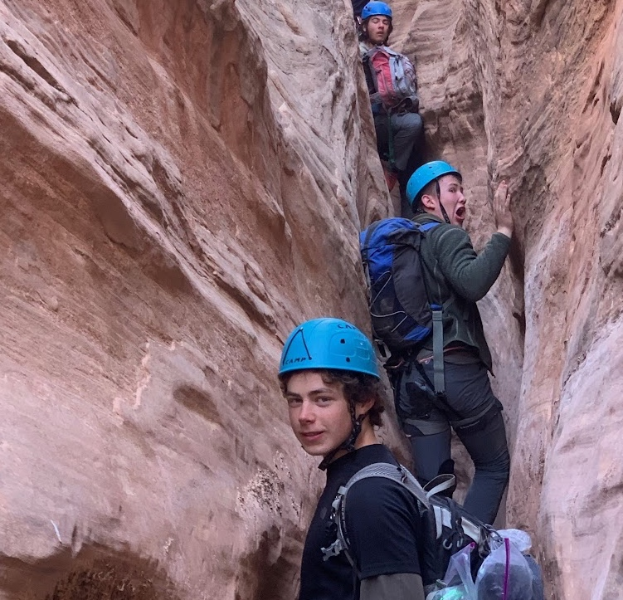
Spring Break – High Adventure
Most Strenuous Trips
14yo+, completed previous trips
Mountain Biking, Rappelling
Longer Distances
Moving Daily
Maturity and stamina are needed

Slide 8
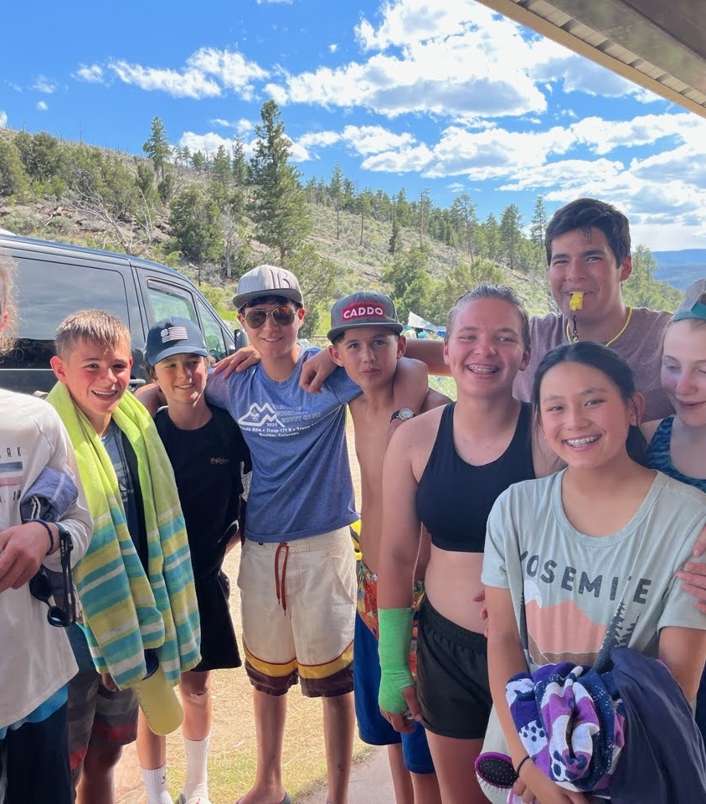
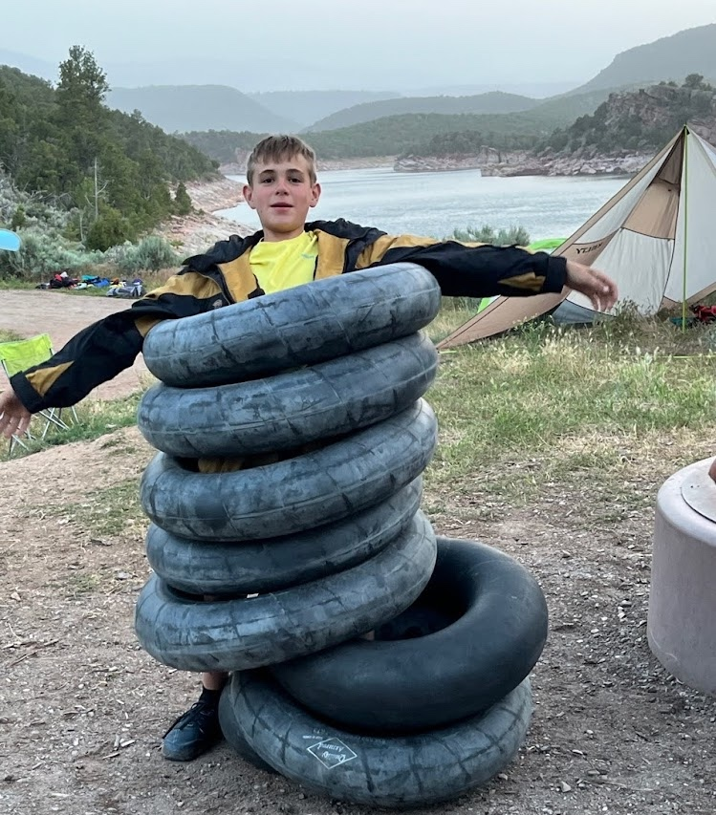
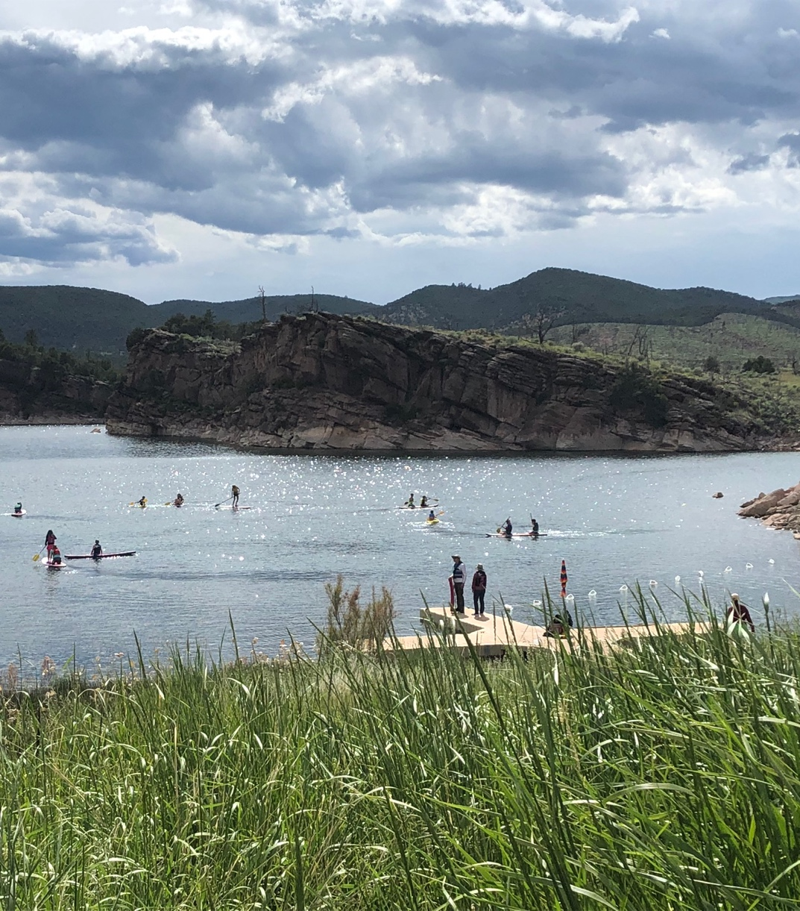
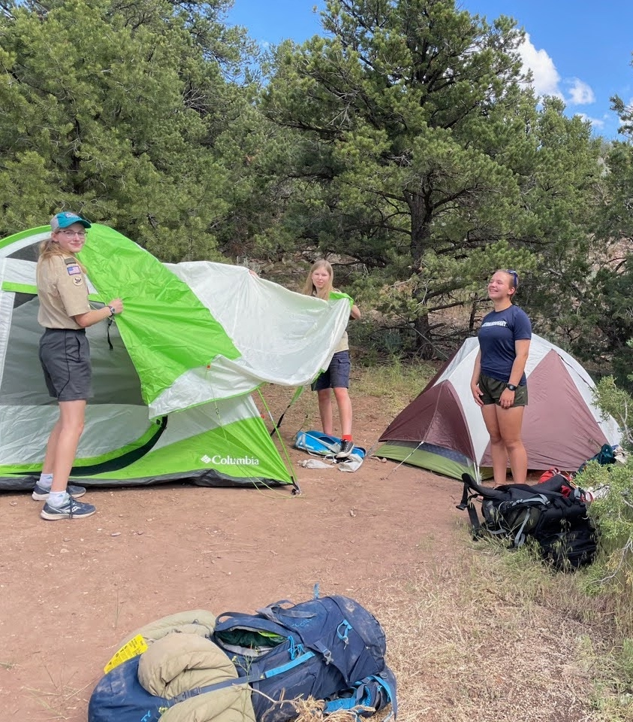
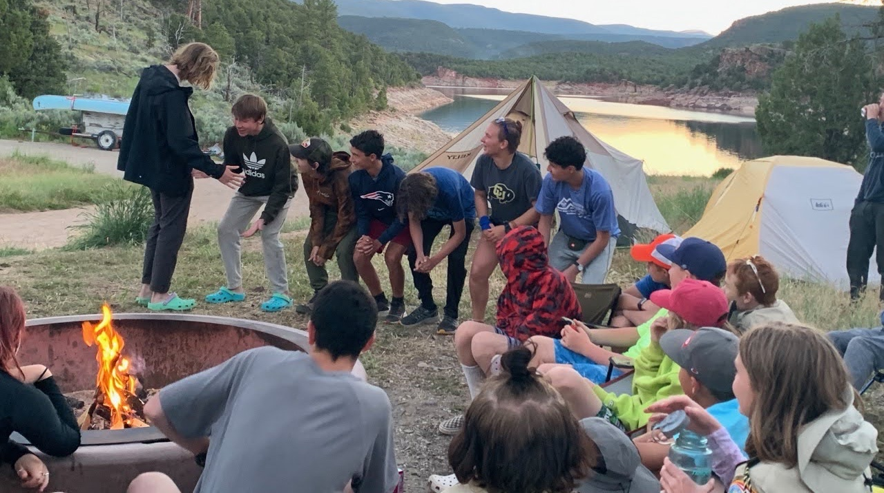
June
Summer Camp!
To keep things interesting, we use Scout Camps south of Denver, in the Black Hills (SD) or our own 171 event in NE Utah on Flaming Gorge Reservoir

Slide 9
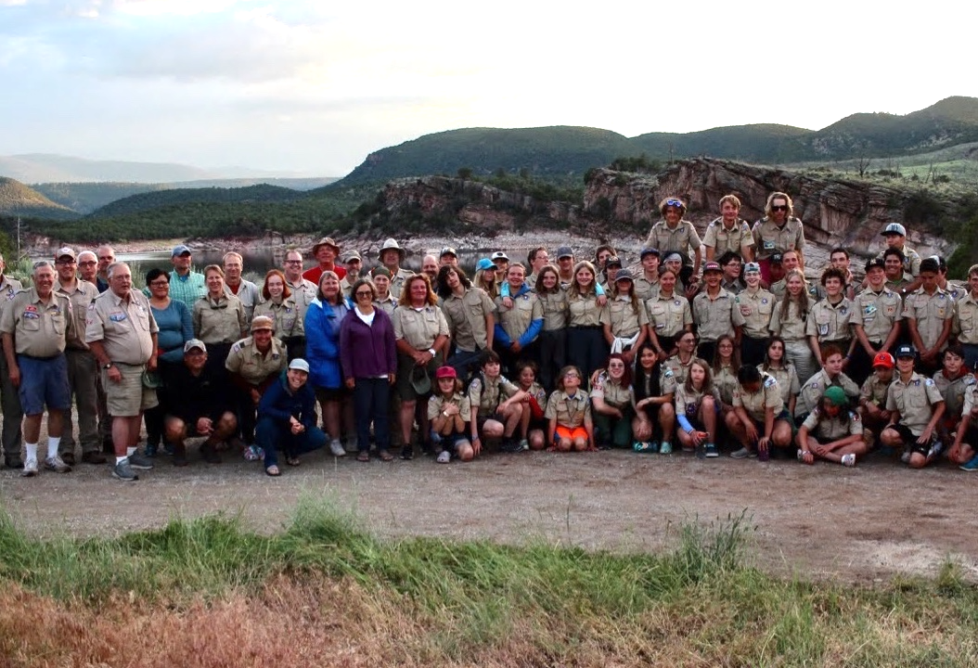
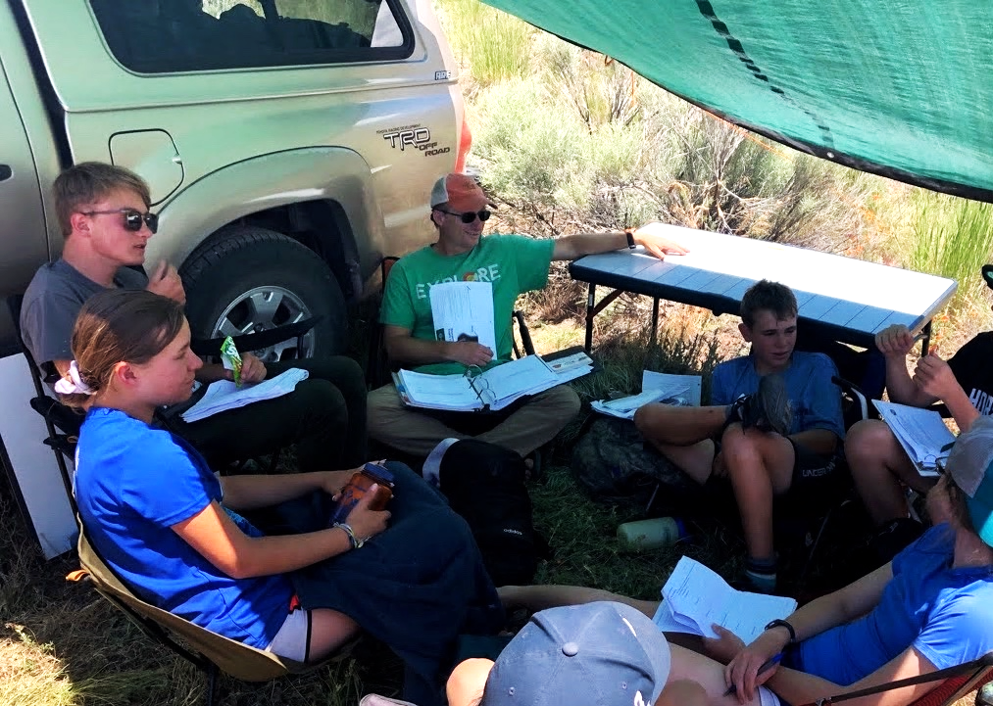
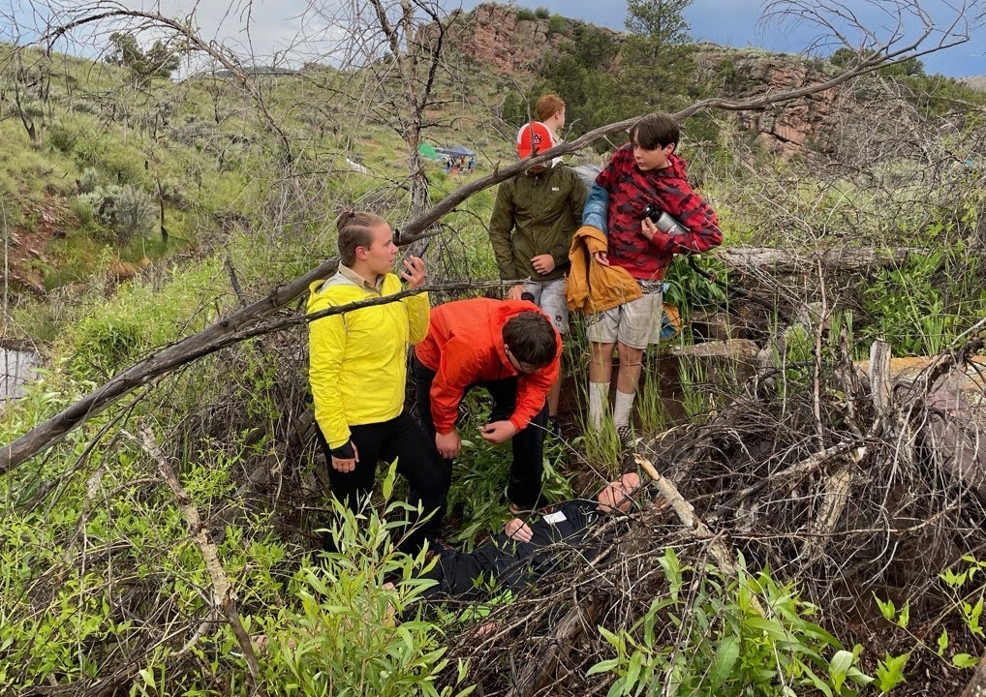
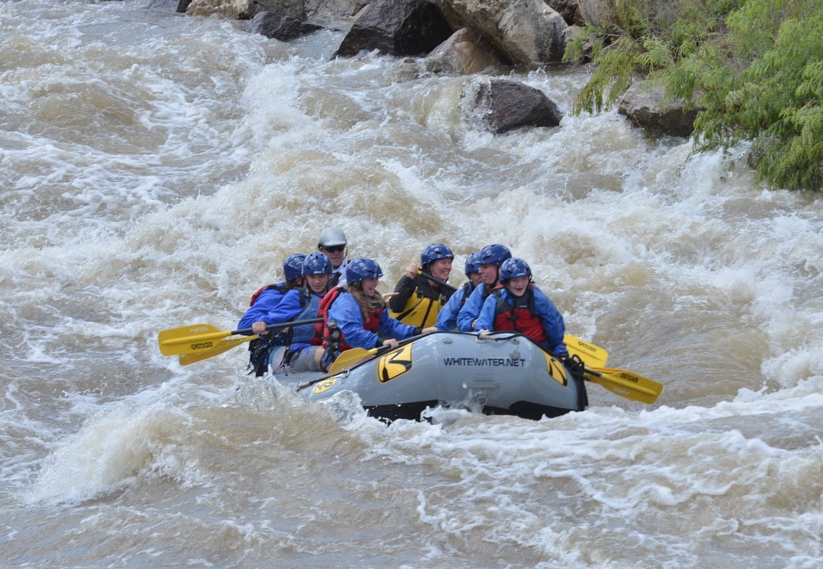
June
Parents augment Scout Leaders in teaching Merit Badges

Slide 10
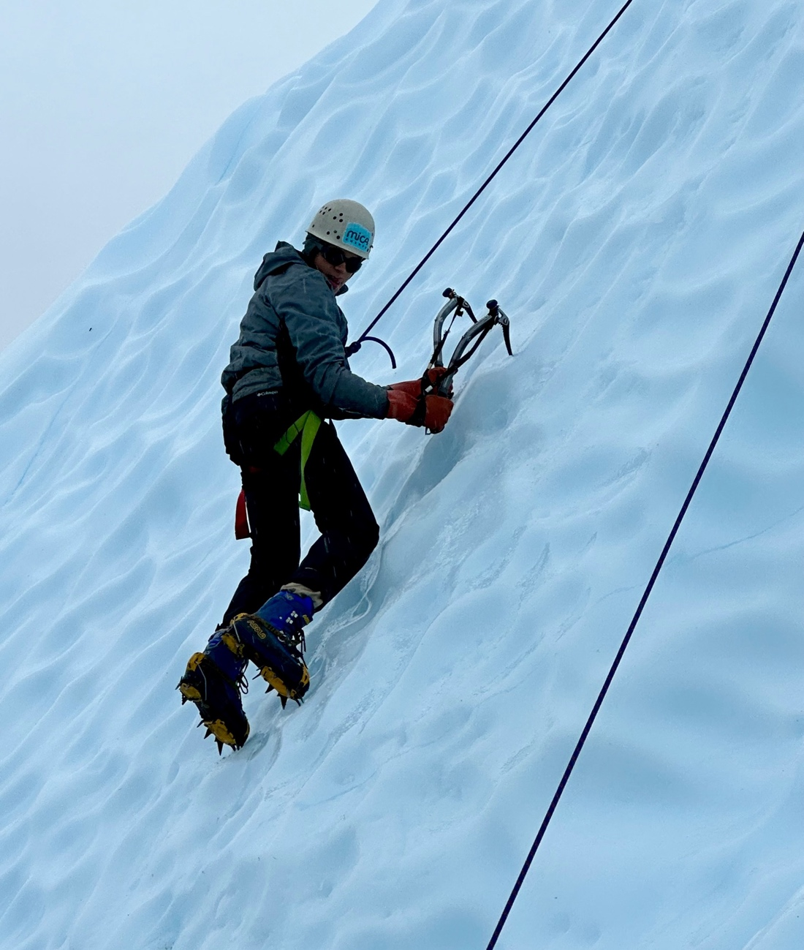
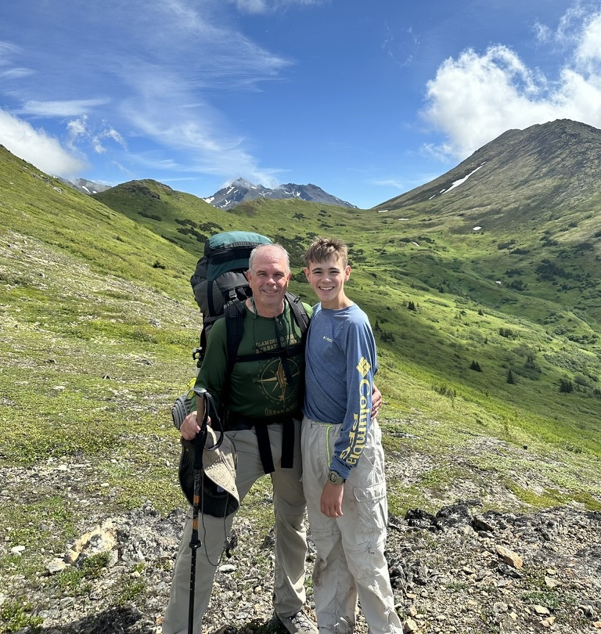
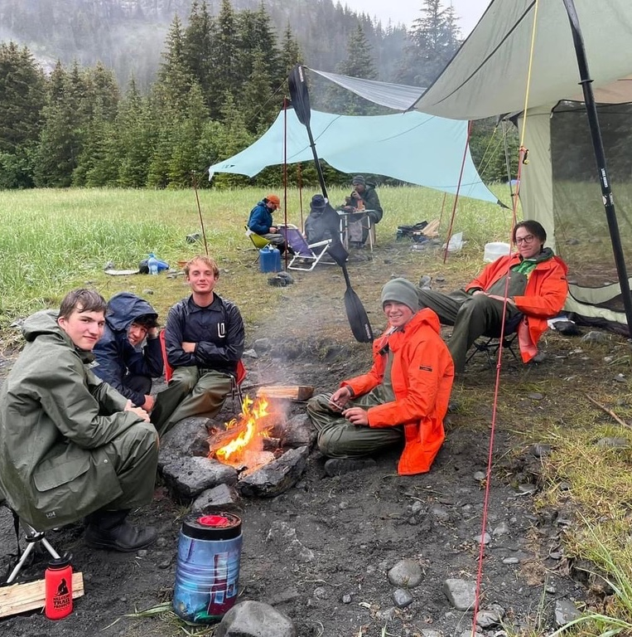
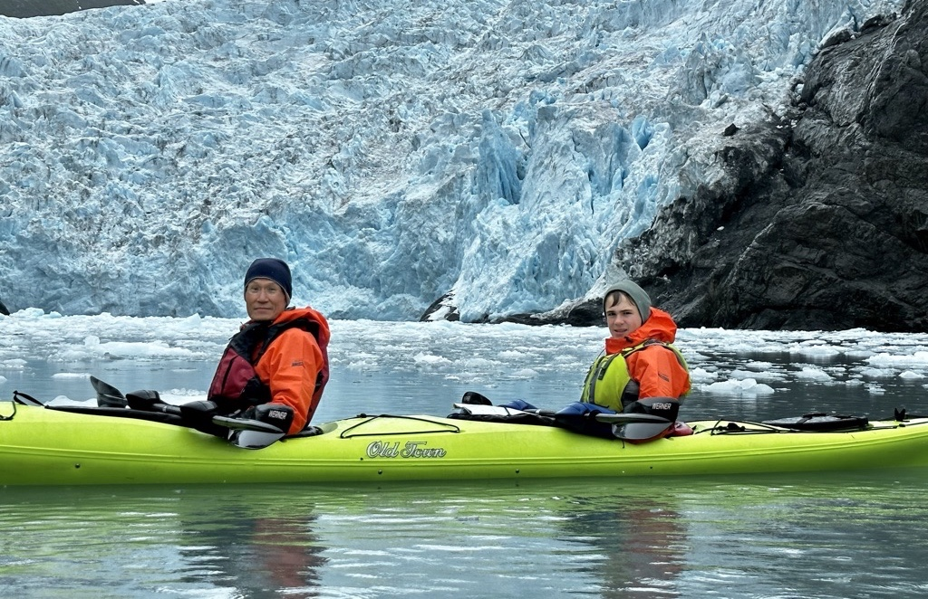
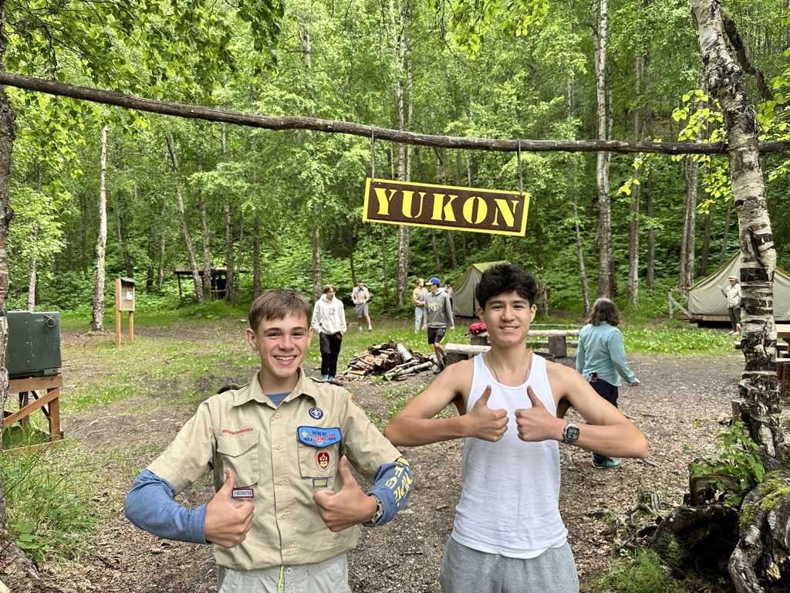
High Adventure - AK
Roughly every 3 years
Two weeks duration
Backpacking, Fishing, Sea Kayaking, Ice Climbing
In and out of Anchorage

Slide 11
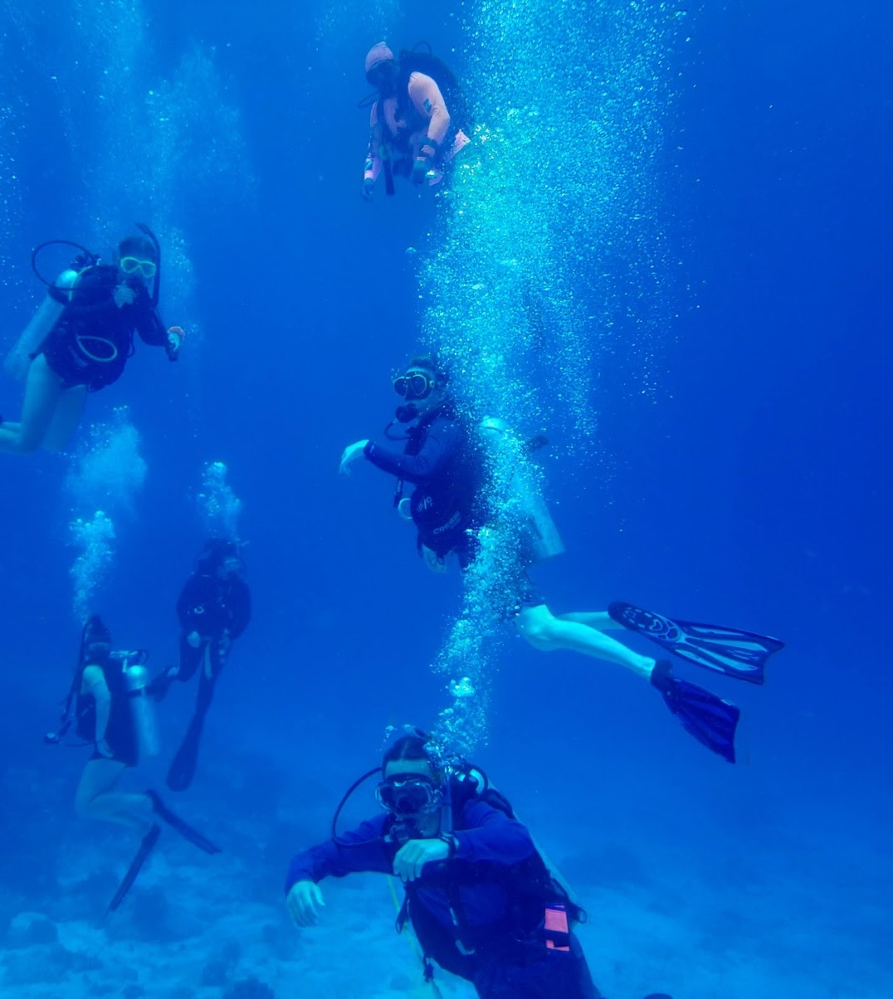
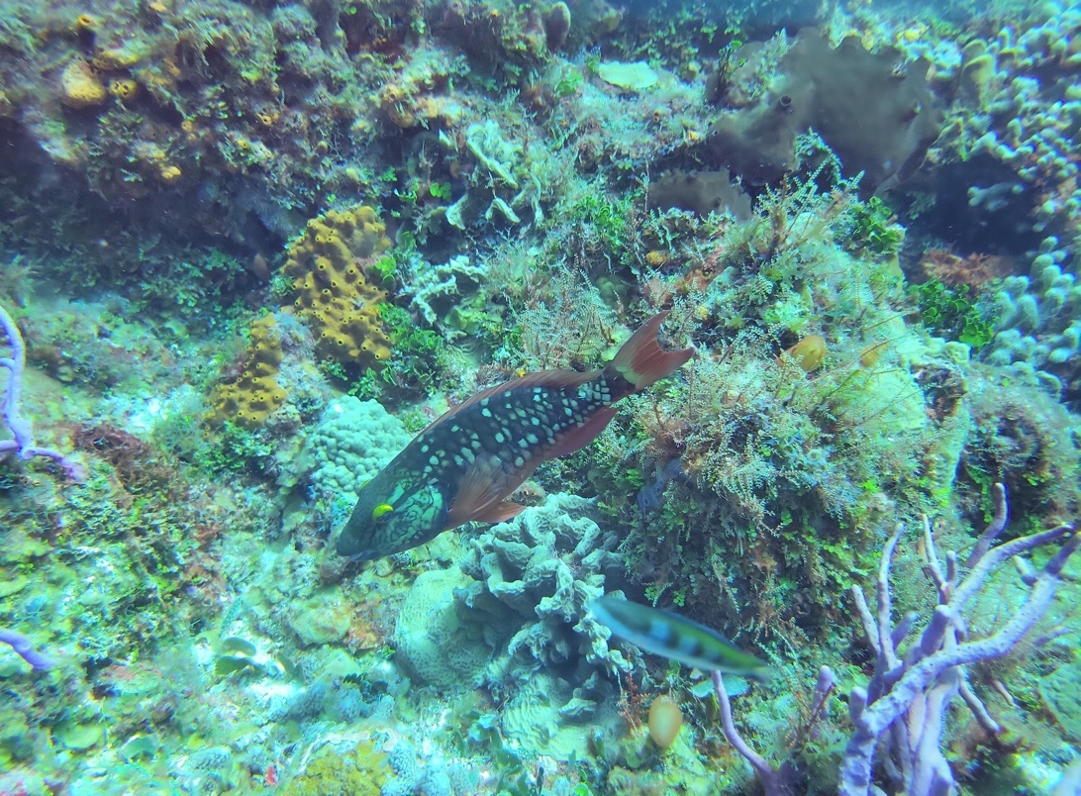
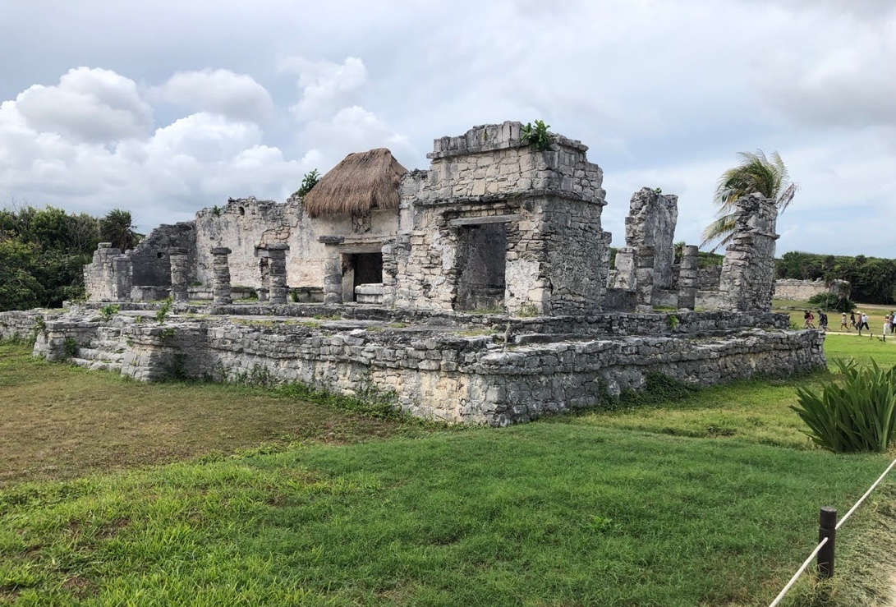
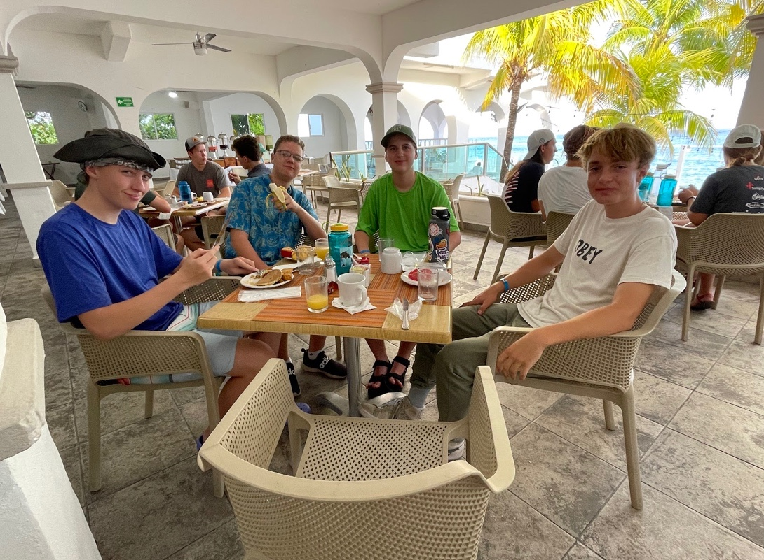
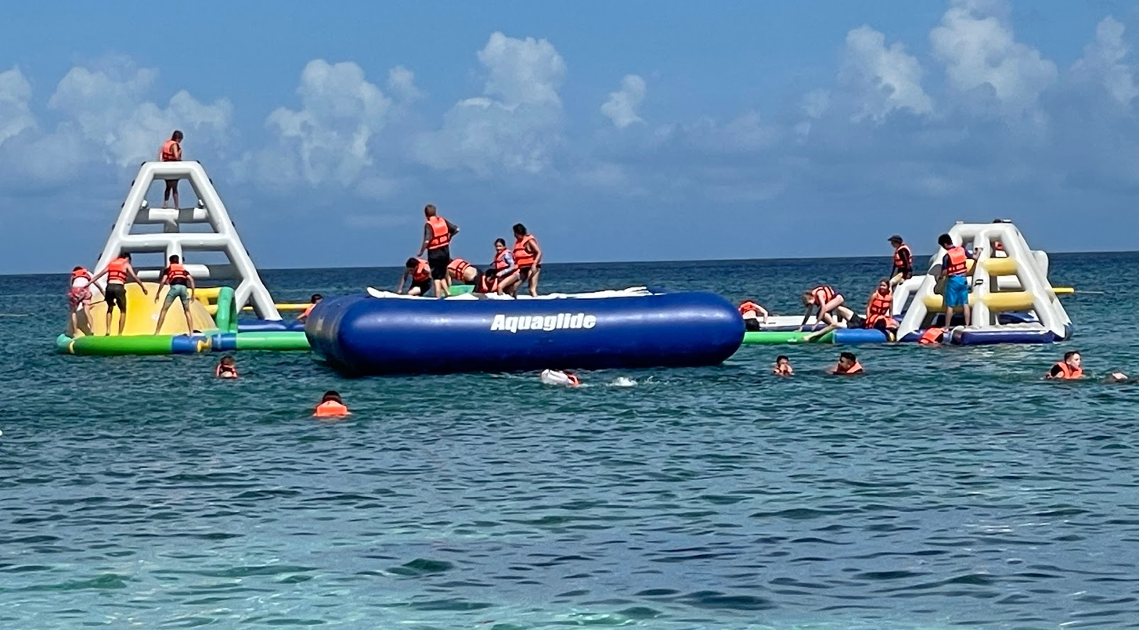
High Adventure - Scuba
Scouts are rigorously certified here in Boulder
Cozumel is a common destination
Local Guides are used, along with Troop Leaders’ and Parents’ help

Slide 12
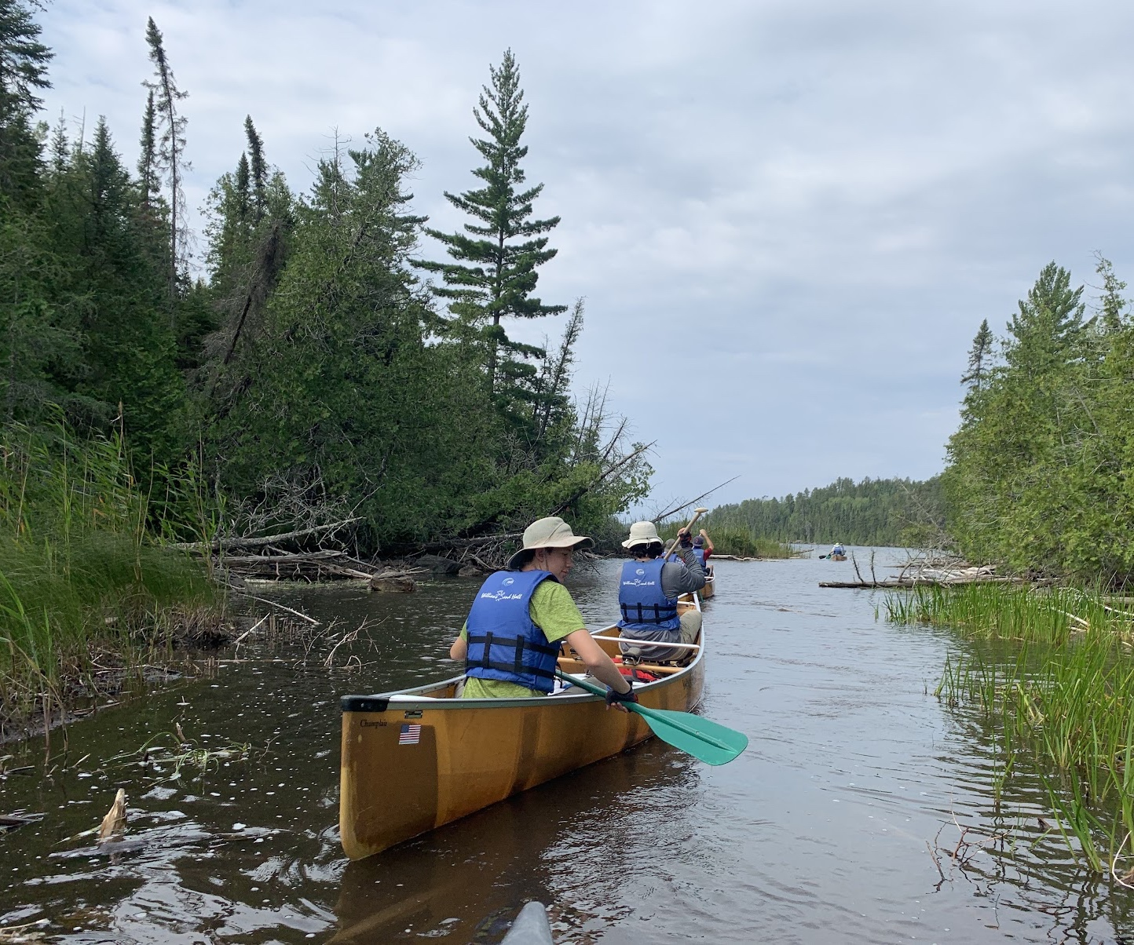
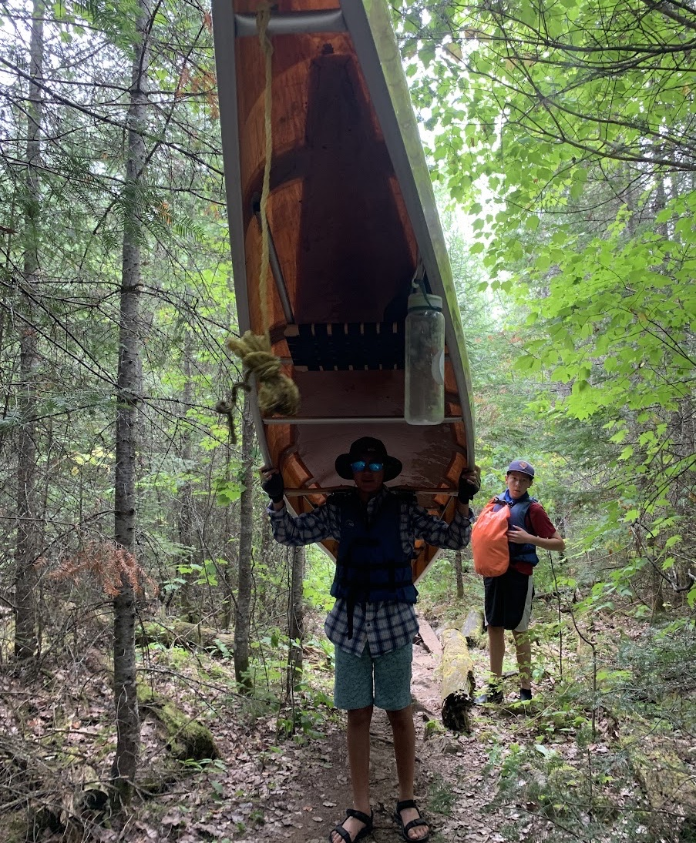
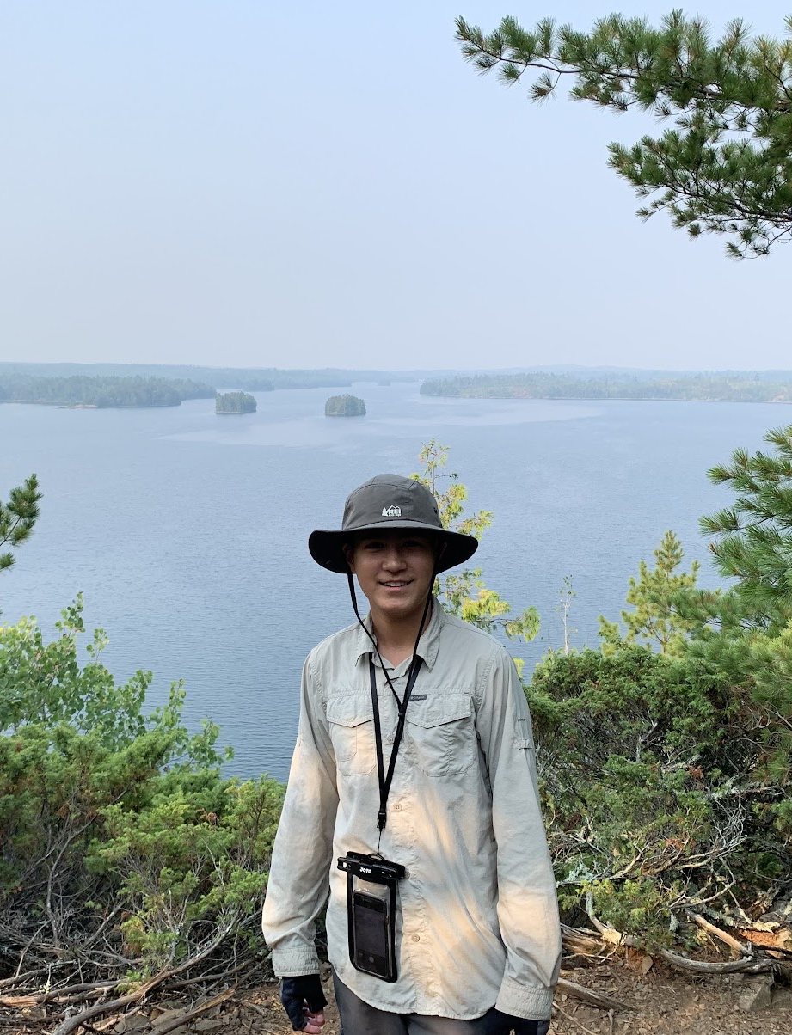
High Adventure – Boundary Waters
Begin and end at the Northern Tier Scout Base Camp
Much gear is sourced there
Bulk of the trip is located in Quetico Provincial Park in Ontario
Fewer visitors resulting in more modest restrictions

Slide 13
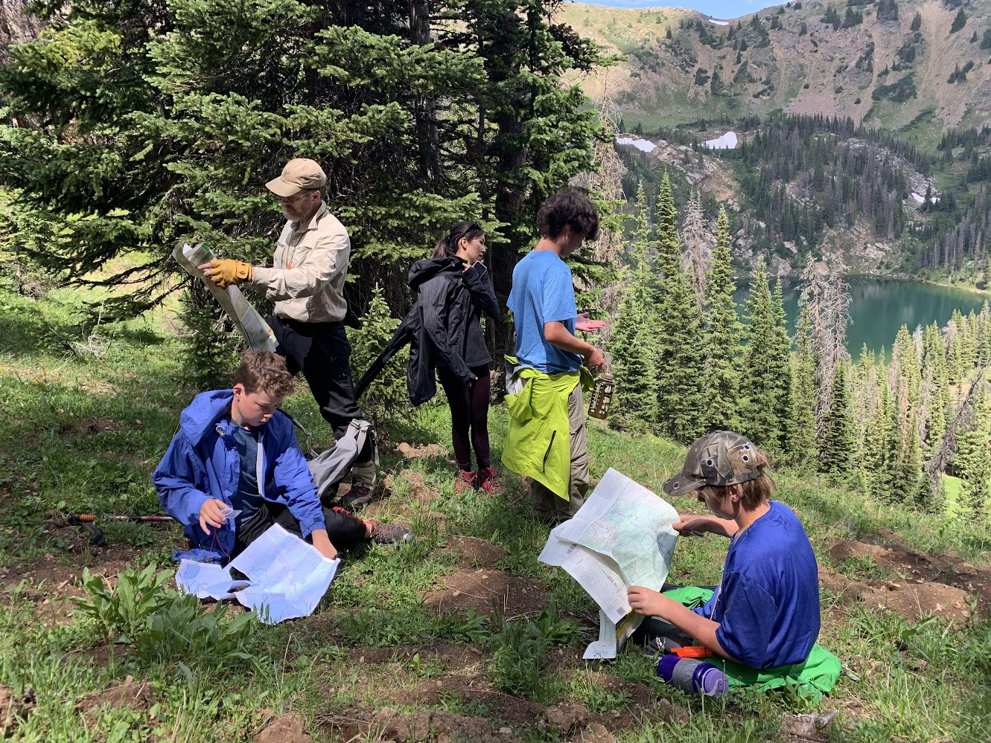
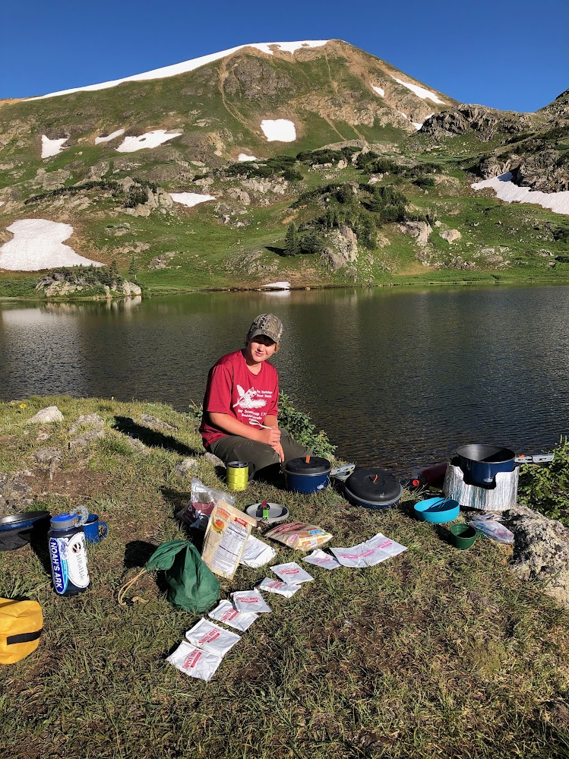
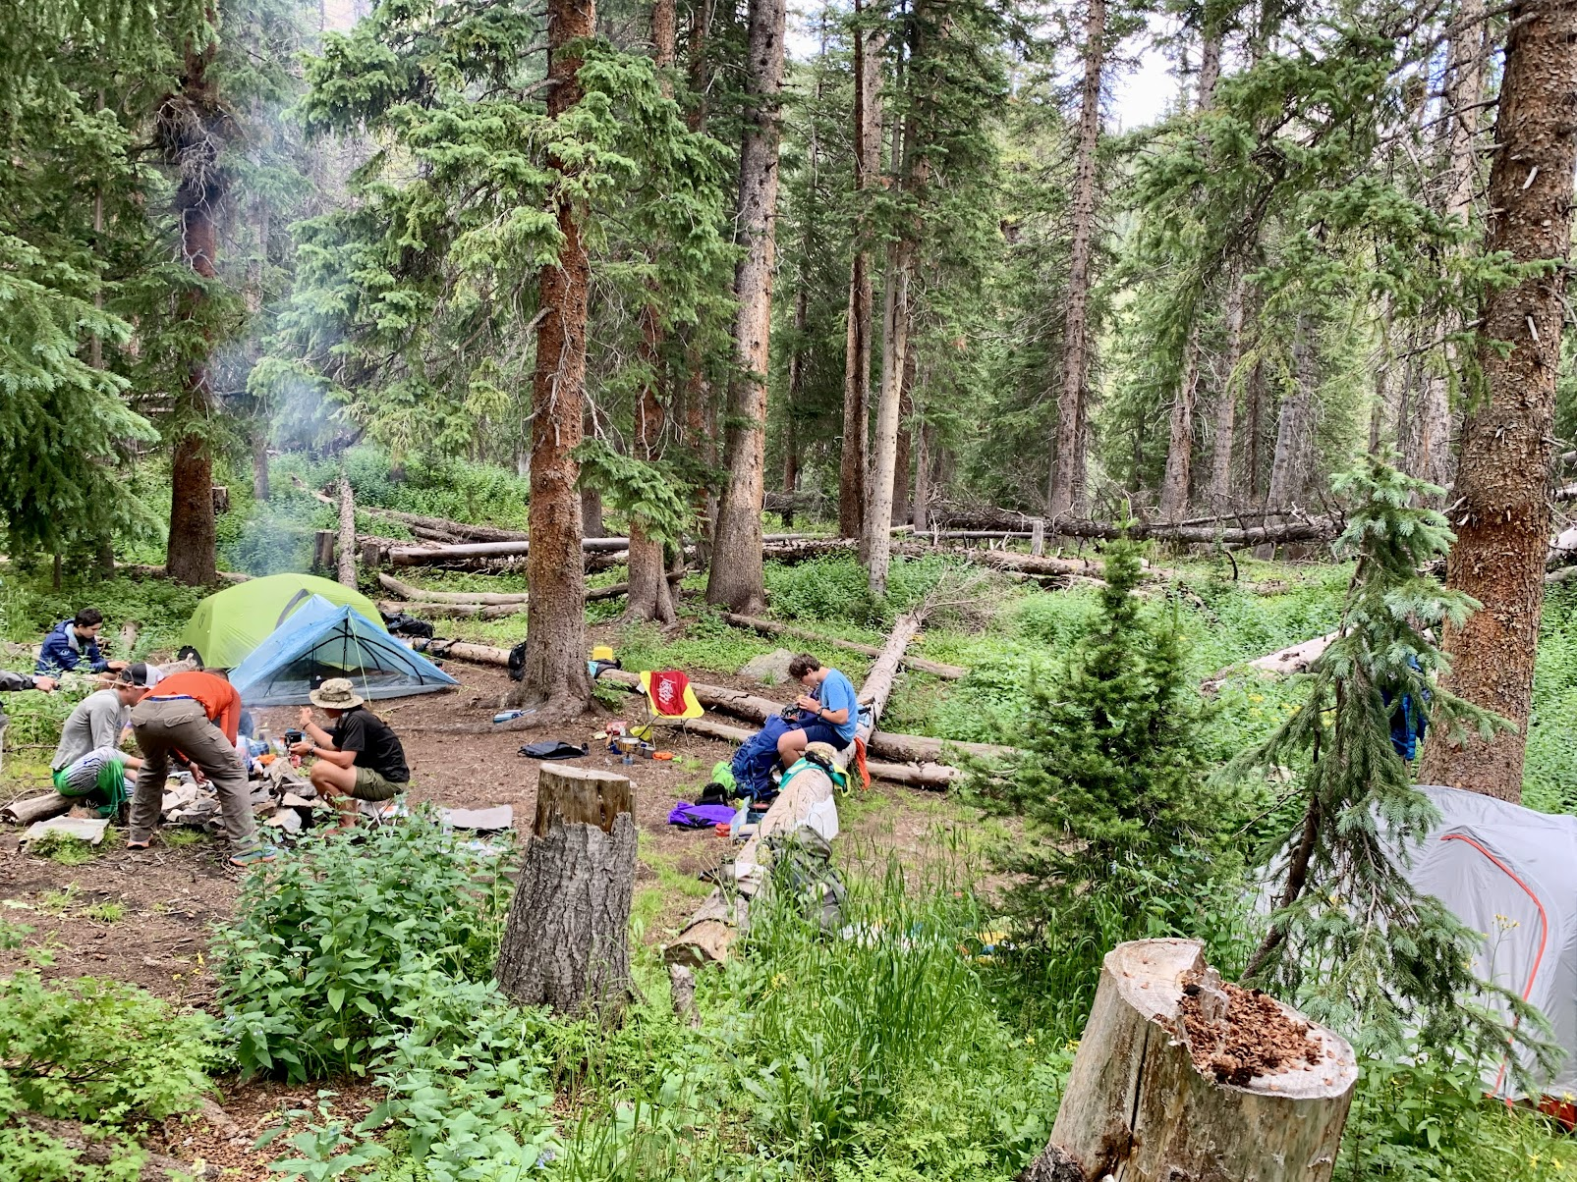
High Adventure – Colorado
Summer trips offered here in Colorado, for those not interested in or able to go out of state
Indian Peaks Wilderness
Maroon Bells
Lost Creek Wilderness

Slide 14
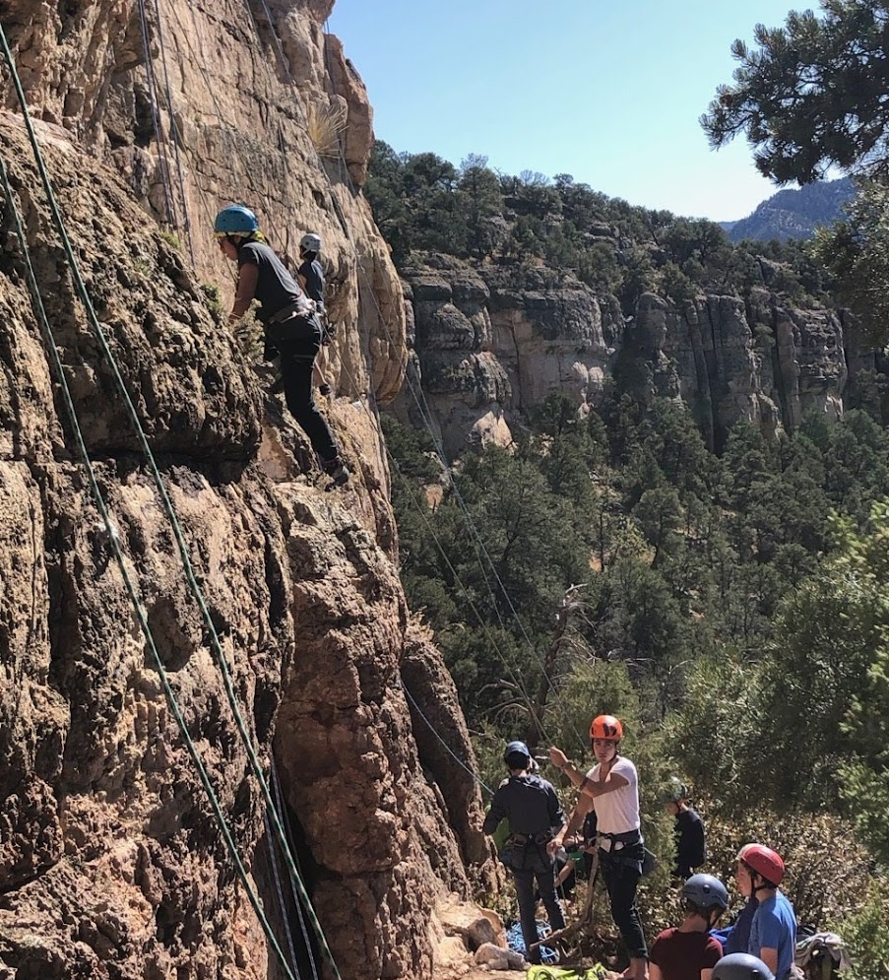
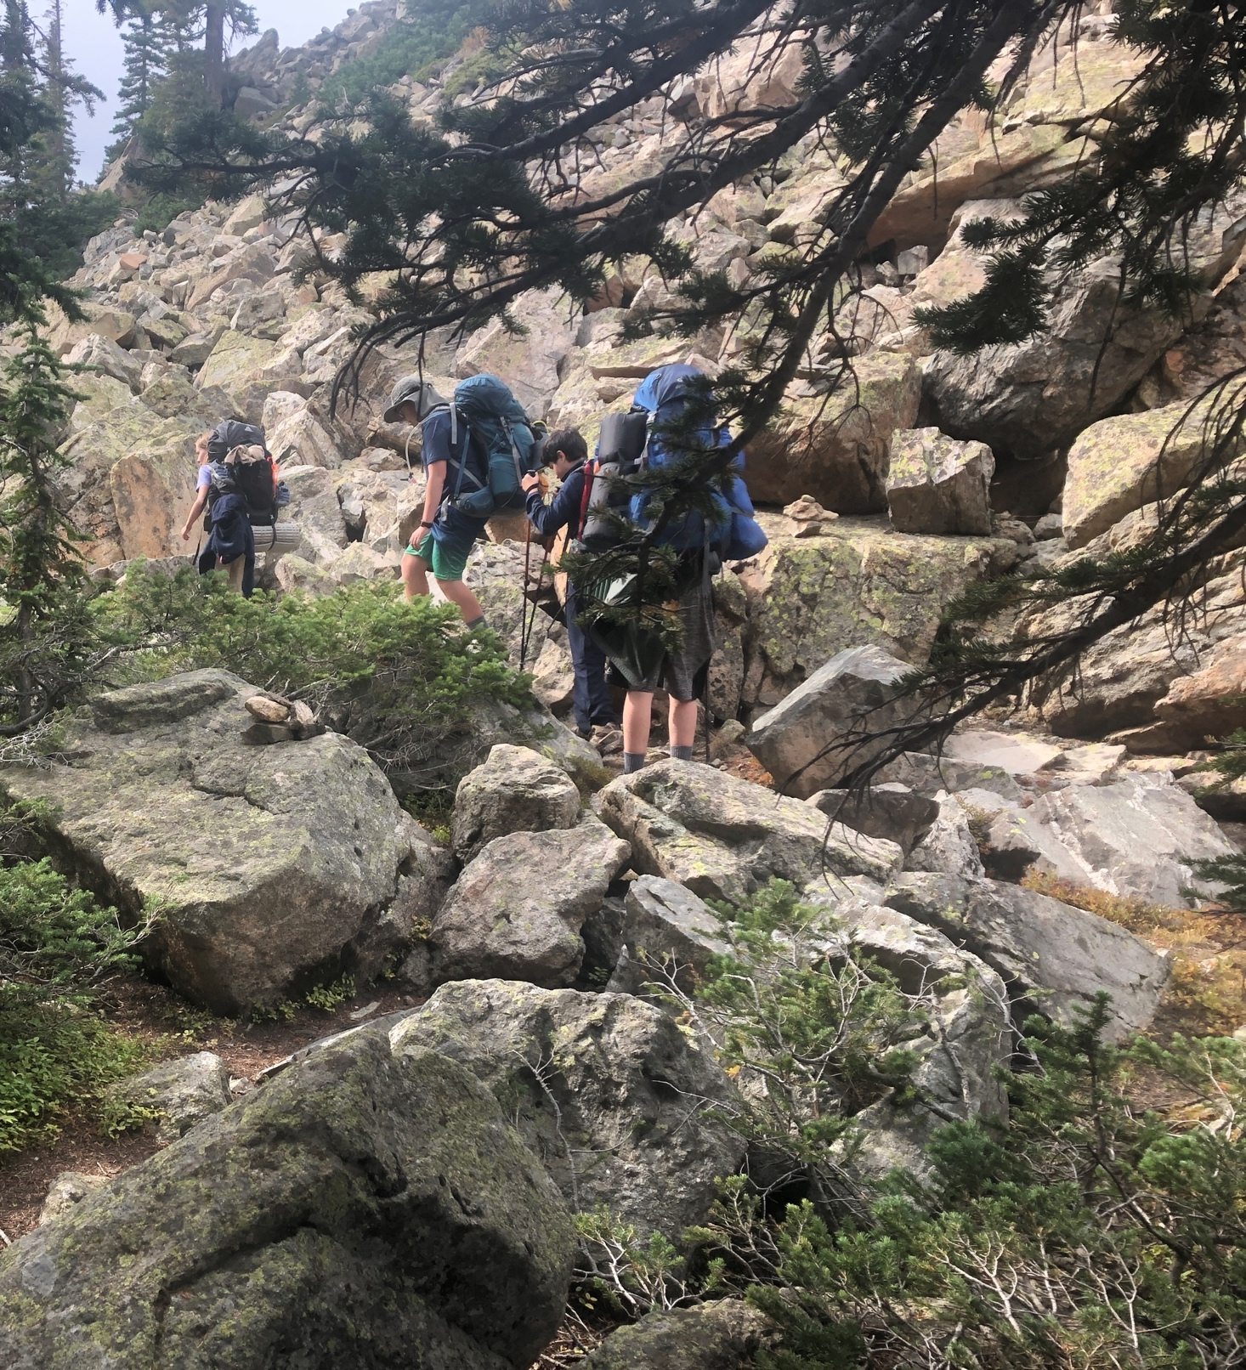
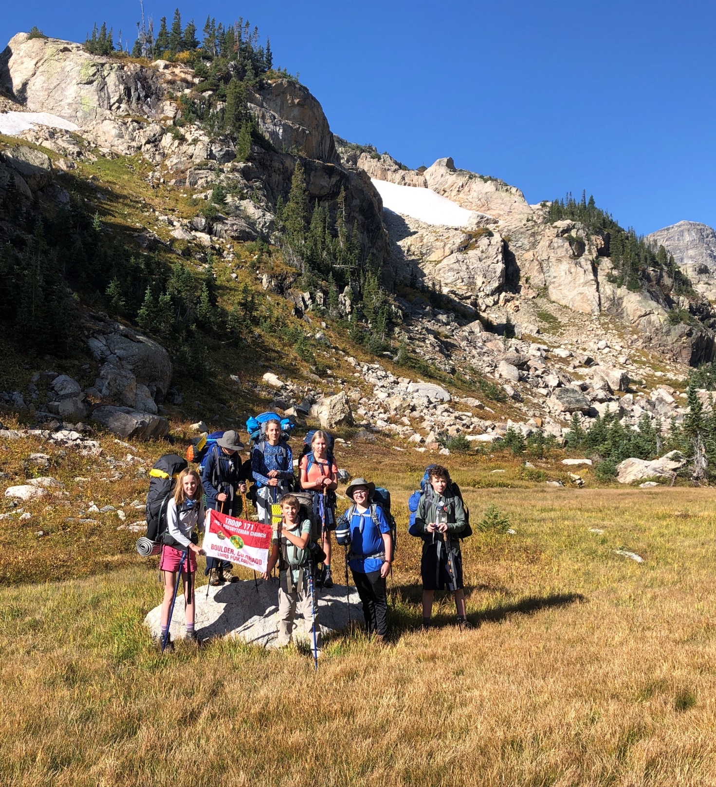
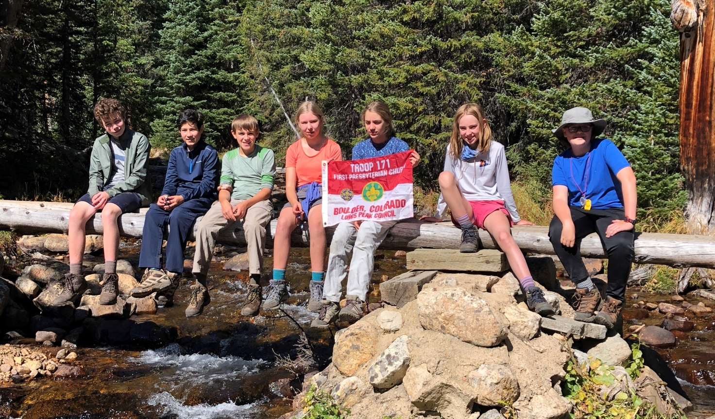
Fall
Prime backpacking time in the Rockies!
Shelf Road
St Vrain Glacier

Slide 15
November
Access to a Scout family’s local property allows our Scouts to:
Cut down trees
Build shelters in which they sleep
Assist with fire mitigation service
Get a taste of winter camping

Slide 16
Questions?

Slide 17
Parent Time

Slide 18
Parent Involvement
We are governed and supported by ~10 Adult Committee members
Aka the Corporate Board
Parents need to be part of this committee
There are ~20 uniformed adults directly supporting the two Troops
Non-uniformed parents are also needed at the Troop level to make this work
Promotion reviews must be completed by parent volunteers
Plan on driving Scouts every 4th trip, even if you are not “on the trip”
Join us on a trip of your liking, we need many adults for safety and sanity
Teaching Merit Badges
There are currently 135 Merit Badges, 21 are required to make Eagle rank
Anyone can be a Merit Badge Counselor – please volunteer!
The teaching requirements are all pre-defined
Personal Data and Pictures
Only top leadership (Scout Masters) have access to your Scout’s contact data
Each trip sign-up sheet has photo release/non-release forms
Communications
Challenges abound in getting Scouts to read and respond to emails and texts
Help foster this life skill!

Slide 19
Rules and Paperwork
Intent – Create respectful, skilled, strong leaders
Means we enforce standards / discipline
Adults “share” feedback responsibility with each other’s kids (not your own)
No “helicopter parents” please
Scout Medical Forms
Yearly medical exam (wellness or school check) with doctor-signed forms
Mandatory Adult Training/Forms
Scout Leaders and Parents who stay overnight with the Troop
Yearly medical exam (wellness check) with doctor-signed forms
Youth Protection Training (YPT)
Adult is never alone with a Scout and never has one-on-one communications with Scouts
Wilderness First Aid/CPR
Bullying and Sexual Abuse Awareness, Weather, Water Safety

Slide 20
Parent Time – Dues, Fees, Materials
The annual Scout National registration fee is $75
Adult volunteers pay a $45 annual fee, which includes cost of a background check
Troop 171 annual dues are $95
Weekend trips are in the $30 to $60 range
Week-long Spring Break and Summer Camps are in the $300 range
Alaska, Scuba, Boundary Waters are in the $3K range
Campership Scholarships available for some trips, but no all
Some uniform items/Handbook are available at McGuckins
Denver BSA store is near 6th and Kipling
We are part of the Adventure West Council
Boulder north to the MT border (except Jackson Hole/Yellowstone), includes West NEB
Our Council store is located at the Loveland Outlet stores
We have a robust Troop “Gear Swap” program
Boulder Sports Recycler on Arapaho can’t be beat

